Slide 1
CCT Exam Topic 2: Cisco Equipment and Hardware
Cisco Certified Technician: CCT
Supporting Cisco Routing & Switching Network Devices
Section 2.1
Identify the interfaces on Cisco equipment

Slide 2
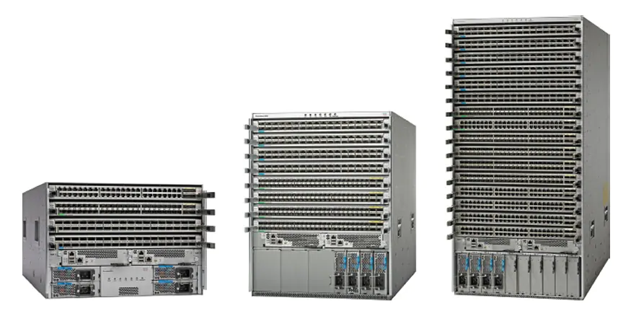
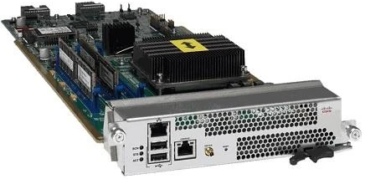
Cisco Certified Technician: CCT
Supporting Cisco Routing & Switching Network Devices
Identifying Cisco Equipment Cisco Nexus 9000 Series
The Cisco Nexus 9000 Series data center switches deliver proven high performance and density up to 400G, as well as low latency and exceptional power efficiency in a range of form factors.
Comprehensive protocol support for Layer 3 (v4/v6) unicast and multicast routing protocol suites.
This platform offers 4, 8, or 16 slot models.
All three switches use the same supervisor, system controller, power supplies, and line cards.
The switches support 1, 10, 25, 40, 50, and 100 Gigabit Ethernet.
Expansion module
Supervisor module

Slide 3
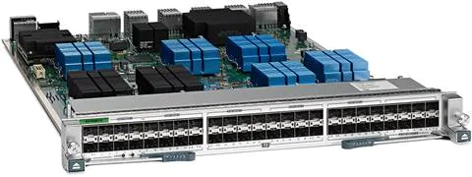
Cisco Certified Technician: CCT
Supporting Cisco Routing & Switching Network Devices
Identifying Cisco Equipment Cisco Nexus 7000 Series
The Nexus 7000 Series switches form the core data center networking fabric. They can provide an end-to-end data center architecture on a single platform, including data center core, aggregation, and access layer.
The modular design of the Nexus 7000 and Nexus 7700 enables them to offer different types of network interfaces—1G, 10G, 40G, and 100.
The chassis can have up to two supervisor modules operating in active and standby modes.
Nexus 7000 switches offer 4, 9, 10, and 18 slots.
Nexus 7700 switches offer 2, 6, 10, and 18 slots
Supervisor module
48-port switch module

Slide 4
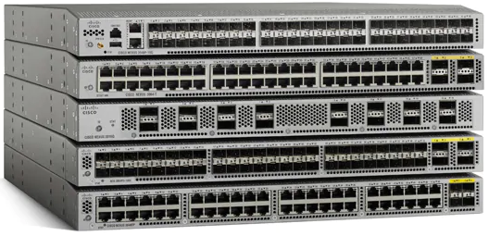
Cisco Certified Technician: CCT
Supporting Cisco Routing & Switching Network Devices
Identifying Cisco Equipment Cisco Nexus 3000 Series
The Cisco Nexus 3000 Series are compact fixed port switches that are excellent for general-purpose deployments, high-performance computing, high-frequency trading, massively scalable data center, and cloud networks.
They are designed for data center top-of-rack deployments by providing 24 to 128 ports offering flexible connectivity, high performance, and a comprehensive feature set.
The 3600 supports 1/10/25/40/100-Gbps connectivity.
The 3500 supports 1/10/40-Gbps connectivity.
The 3400 supports 1/10/25/40/100/400Gbps connectivity.

Slide 5
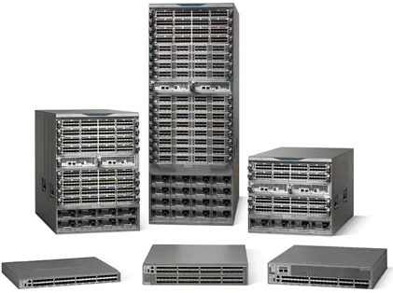
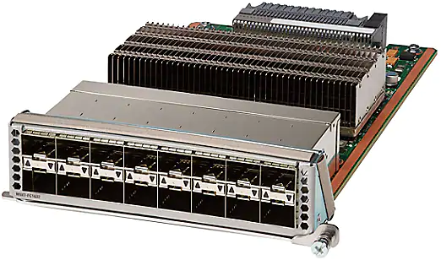
Cisco Certified Technician: CCT
Supporting Cisco Routing & Switching Network Devices
Identifying Cisco Equipment Cisco Nexus MDS 9000 Series
The Cisco MDS 9000 multilayer storage area network (SAN) switches combine a robust, flexible hardware architecture with multiple layers of network and storage-management intelligence.
They allow for building highly available, scalable storage networks with advanced security and unified management.
The product family also facilitates server storage and fabric virtualization, providing an end-to-end virtualization solution for the data center.
Expansion module

Slide 6
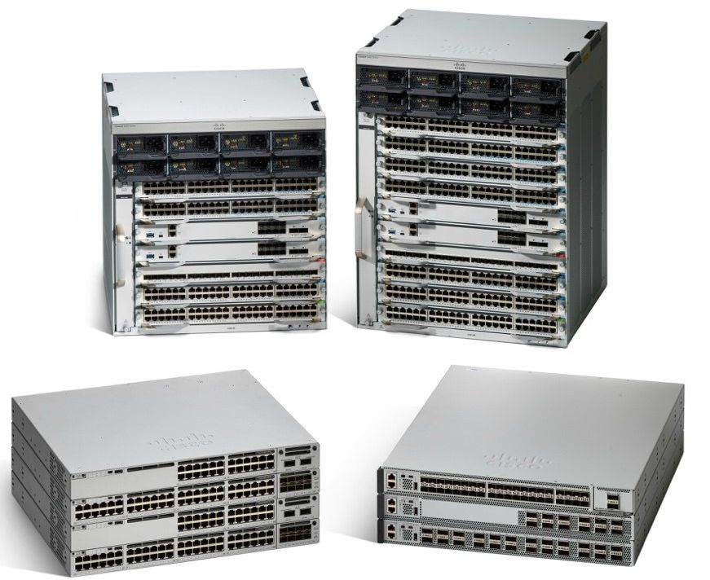
Cisco Certified Technician: CCT
Supporting Cisco Routing & Switching Network Devices
Identifying Cisco Equipment Cisco Catalyst 9000 Series Switches
The Cisco MDS 9000 multilayer storage area network (SAN) switches combine a robust, flexible hardware architecture with multiple layers of network and storage-management intelligence.
The Catalyst family now extends to wireless, including new industry-leading Wi-Fi 6 (802.11ax) access points and the modular campus core.
The Cisco Catalyst 9300 Series switches are a leading fixed enterprise access switching platform.
Delivers 480 Gbps stacking bandwidth capacity.
Flexible downlinks: Cisco Multigigabit, 5 Gbps, 2.5 Gbps, or 1 Gbps copper, or 1 Gbps fiber.
Video – Catalyst 9000 Series Overview
Expansion module

Slide 7
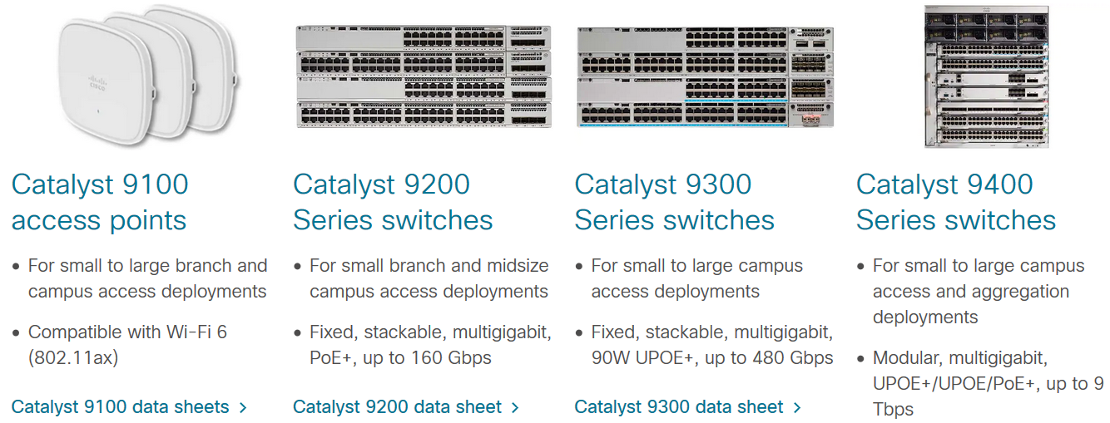
Cisco Certified Technician: CCT
Supporting Cisco Routing & Switching Network Devices
Identifying Cisco Equipment Cisco Catalyst 9000 Series

Slide 8
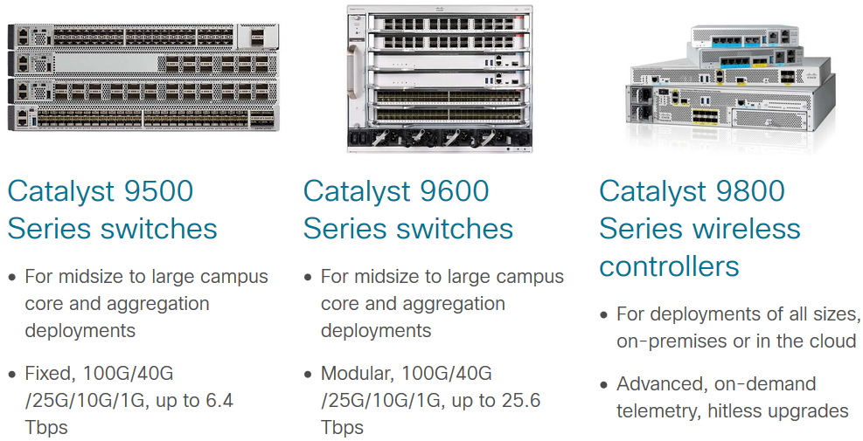
Cisco Certified Technician: CCT
Supporting Cisco Routing & Switching Network Devices
Identifying Cisco Equipment Cisco Catalyst 9000 Series

Slide 9
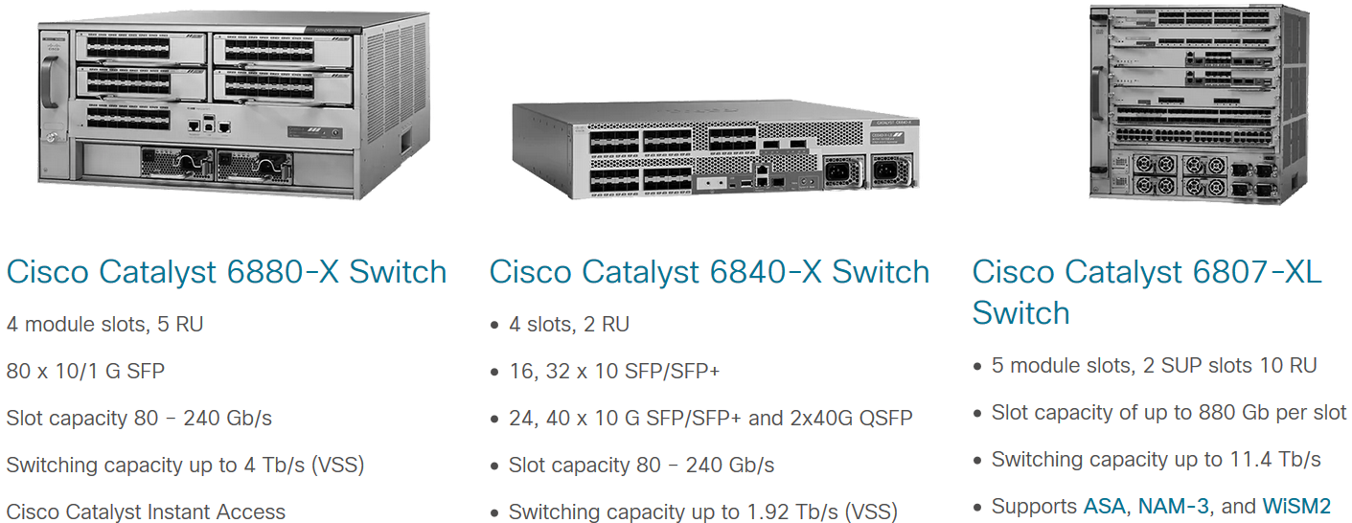
Cisco Certified Technician: CCT
Supporting Cisco Routing & Switching Network Devices
Identifying Cisco Equipment Cisco Catalyst 6800 Series Switches
Catalyst 6800 Series switches are powerful campus backbone switches optimized for Multigigabit Ethernet services to help you protect your network investment.
Video – Catalyst 6800 Series Overview

Slide 10
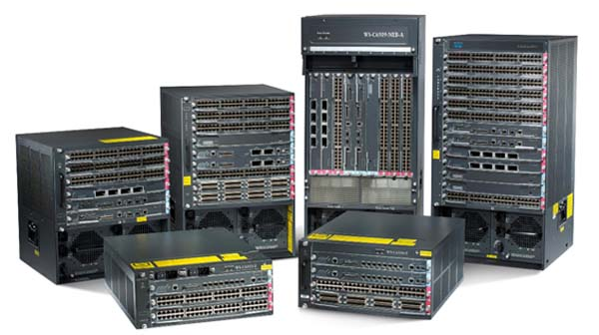
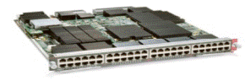
Cisco Certified Technician: CCT
Supporting Cisco Routing & Switching Network Devices
Identifying and working with Cisco Routers and Switches Catalyst 6500 Series Switches
WS-C65013-E
The Cisco Catalyst 6500-E Series chassis offers industry-leading 10/100/1000 Gigabit Ethernet, 10 Gigabit Ethernet and 40 Gigabit Ethernet port densities while providing high levels of network resilience.
The 6500-E Series offer high port densities and are available in 3, 4, 6, 9, 9-vertical, and 13 slot versions to allow for a wide range of deployment scenarios.
The 6500-E Series chassis supports all the Cisco Catalyst 6500 Supervisor Engines and associated LAN, WAN, and services modules.
WS-C6509-V-E
WS-C6509-E
WS-C6506-E
WS-C6503-E
WS-C6504-E
48-port switch module

Slide 11
Cisco Certified Technician: CCT
Supporting Cisco Routing & Switching Network Devices
Identifying and working with Cisco Routers and Switches Catalyst 6500 Series Switches
WS-C65013-E
As the premier Cisco modular multilayer switch, the Cisco Catalyst 6500 Series delivers secure, converged services from the wiring closet to the core, to the data center, and to the WAN edge.
The versatile Cisco Catalyst 6500-E Series Chassis is ideal for addressing high-performance, high- port-density Fast Ethernet, Gigabit Ethernet, and 10 and 40 Gigabit Ethernet applications in all parts of the network. This series is ideally suited for enterprise core and aggregation environments.
WS-C6509-V-E
WS-C6509-E
WS-C6506-E
WS-C6503-E
WS-C6504-E
48-port switch module

Slide 12
Cisco Certified Technician: CCT
Supporting Cisco Routing & Switching Network Devices
Identifying and working with Cisco Routers and Switches Catalyst 3850 Series Switches
Stackable Catalyst 3850 Series multigigabit and 10-Gbps network switches give you wired and wireless together so you can scale up and protect your investments.
Video – Catalyst 3850 Series Overview

Slide 13
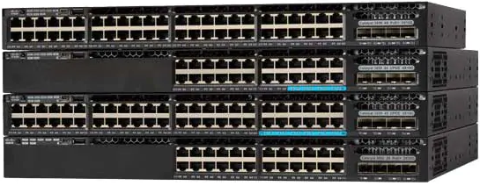
Cisco Certified Technician: CCT
Supporting Cisco Routing & Switching Network Devices
Identifying and working with Cisco Routers and Switches Catalyst 3650 Series Switches
The 3650 Series is built on the advanced Cisco StackWise®-160, and takes advantage of the new Cisco Unified Access™ Data Plane (UADP) application-specific integrated circuit (ASIC).

Slide 14
Cisco Certified Technician: CCT
Supporting Cisco Routing & Switching Network Devices
Identifying and working with Cisco Routers and Switches Catalyst 3650 Series Switches
From the Catalyst 3650 mini series to the Catalyst 3650 multigigabit and Universal Power over Ethernet (UPOE) switches, your network is ready for the mobile devices and applications it needs to support.

Slide 15
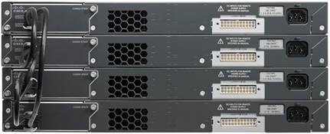
Cisco Certified Technician: CCT
Supporting Cisco Routing & Switching Network Devices
Identifying and working with Cisco Routers and Switches Catalyst 2960 Series Switches
Cisco Catalyst 2960-X and 2960-XR Series Switches are fixed-configuration, stackable Gigabit Ethernet switches that provide enterprise-class access for campus and branch applications.
These fully managed switches can provide advanced Layer 2 and Layer 3 features as well as optional Power over Ethernet Plus (PoE+) power.
24 or 48 Gigabit Ethernet ports
Uplink ports – available with 1 Gigabit Ethernet Small Form-Factor Pluggable (SFP) uplinks or fixed 10 Gigabit Ethernet SFP+ uplinks.
Stacked deployment

Slide 16
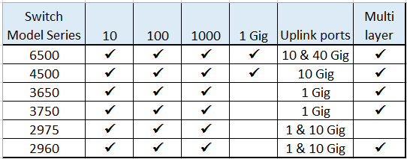
Cisco Certified Technician: CCT
Supporting Cisco Routing & Switching Network Devices
Identifying and working with Cisco Routers and Switches Catalyst Switch Series Comparison

Slide 17
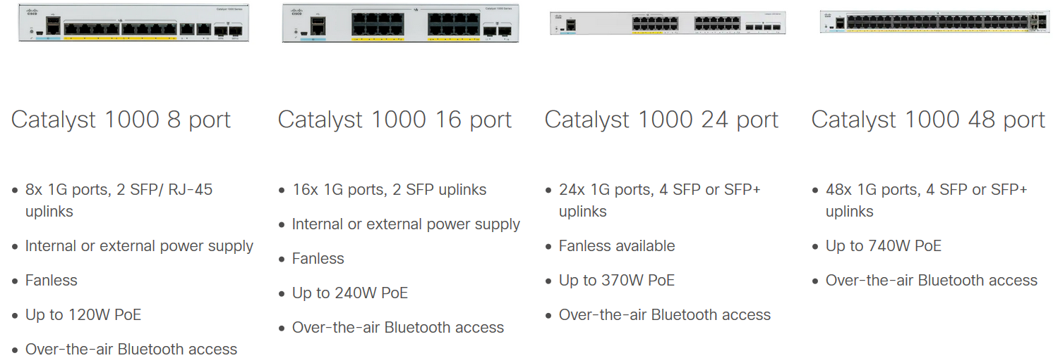
Cisco Certified Technician: CCT
Supporting Cisco Routing & Switching Network Devices
Identifying and working with Cisco Routers and Switches Catalyst 1000 Series Switches
Cisco Catalyst 1000 Series Switches are fixed managed Gigabit Ethernet enterprise-class Layer 2 switches designed for small businesses and branch offices.
Cisco Catalyst 1000 Series switches provide enterprise-grade network access sized for small businesses.

Slide 18
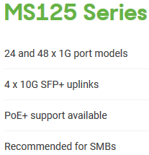
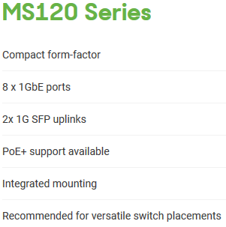
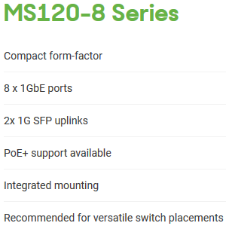
Cisco Certified Technician: CCT
Supporting Cisco Routing & Switching Network Devices
Identifying and working with Cisco Routers and Switches Meraki– Access Switches
Meraki Switches combine simplicity the simplicity of the cloud-managed dashboard with the power of enterprise-grade hardware, to cater to the demands of next-gen wired and wireless networks.

Slide 19
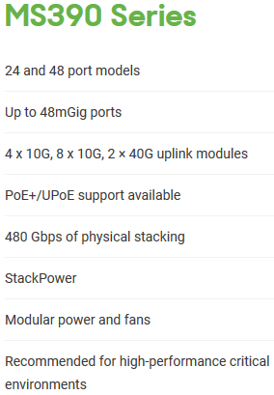
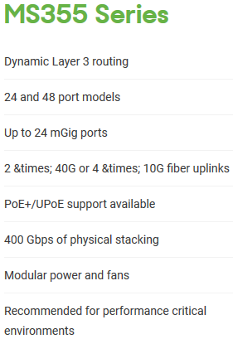
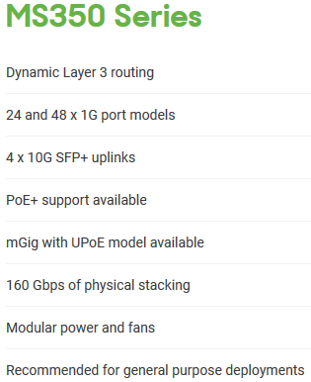
Cisco Certified Technician: CCT
Supporting Cisco Routing & Switching Network Devices
Identifying and working with Cisco Routers and Switches Meraki– Stackable Access Switches
Meraki access and aggregation layer switches power networks of every size.

Slide 20
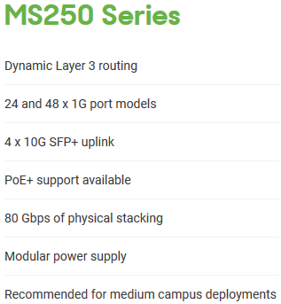
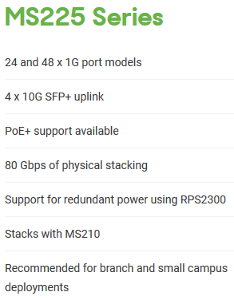
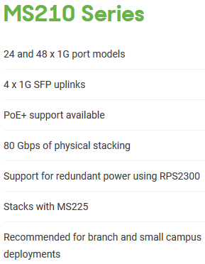
Cisco Certified Technician: CCT
Supporting Cisco Routing & Switching Network Devices
Identifying and working with Cisco Routers and Switches Meraki Switches
They combine secure, scalable, robust performance with an intuitive management experience that requires no additional training.

Slide 21
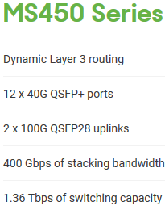
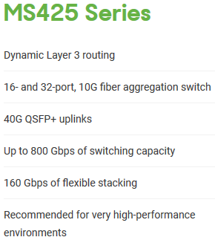
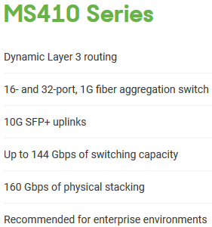
Cisco Certified Technician: CCT
Supporting Cisco Routing & Switching Network Devices
Identifying and working with Cisco Routers and Switches Meraki– Aggregation Switches
The Cisco Meraki MS400 Series brings powerful cloud-managed switching to the aggregation layer.

Slide 22
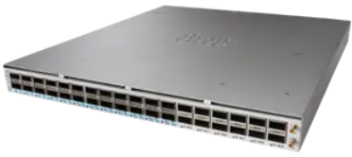
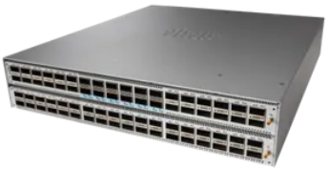
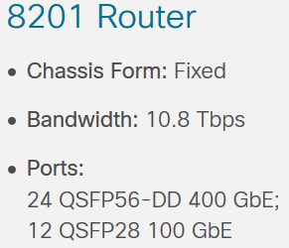
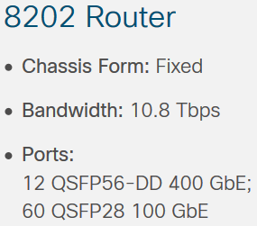
Cisco Certified Technician: CCT
Supporting Cisco Routing & Switching Network Devices
Identifying and working with Cisco Routers and Switches Cisco 8000 Series Routers
The 8200 Series 1 and 2 RU footprints allow them to be deployed in locations that traditionally required much larger chassis and special accommodations for power and cooling.

Slide 23
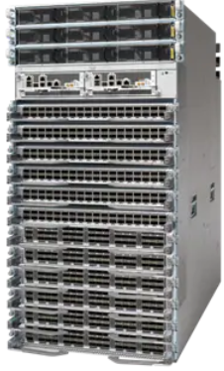
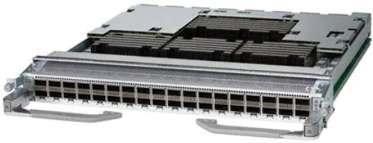
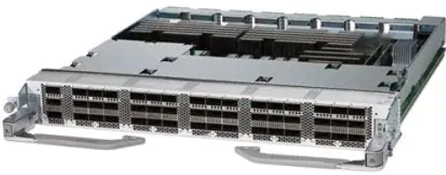
Cisco Certified Technician: CCT
Supporting Cisco Routing & Switching Network Devices
Identifying and working with Cisco Routers and Switches Cisco 8000 Series Routers
The Cisco 8800 Series delivers breakthrough density up to 260 Tbps using 648 400 GbE ports and enables greater savings by reducing the number of routers required in a given location – potentially removing entire layers from a network.
36-port QSFP56-DD 400 GbE line card
48-port QSFP28 100 GbE line card

Slide 24
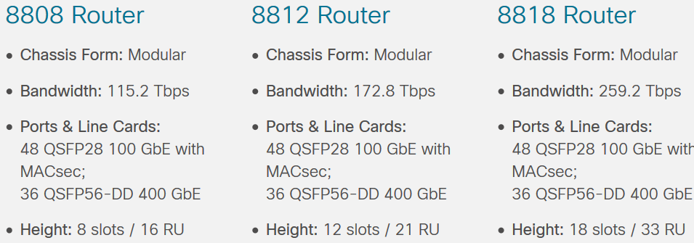
Cisco Certified Technician: CCT
Supporting Cisco Routing & Switching Network Devices
Identifying and working with Cisco Routers and Switches Cisco 8000 Series Routers
In addition to reducing per-port power relative to previous generations, the Cisco 8800 Series enables even greater savings by reducing the number of routers required in a given location.
Video – Cisco 8000 Series Router Overview

Slide 25
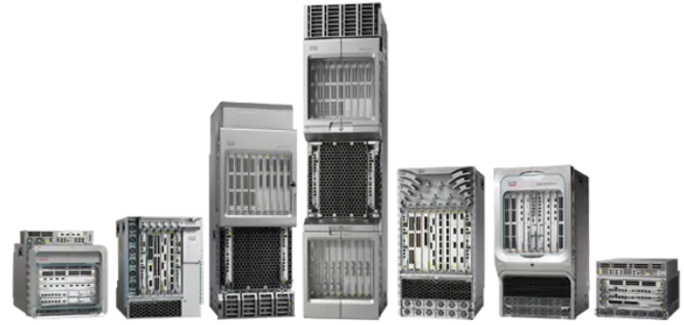
Cisco Certified Technician: CCT
Supporting Cisco Routing & Switching Network Devices
Identifying and working with Cisco Routers and Switches Cisco ASR 9000 Series Routers
The ASR 9000 series an edge routing device capable of supporting the application performance required to power 5G service needs.
Video – Cisco ASR 9000 Series Router Overview

Slide 26
Cisco Certified Technician: CCT
Supporting Cisco Routing & Switching Network Devices
Identifying and working with Cisco Routers and Switches Cisco ASR 9000 Series Routers
The Cisco ASR 9000 Series Aggregation Services Routers (ASR 9000 Series) represent an exciting new paradigm in edge and core routing, with exceptional scalability, carrier-class reliability, environmentally conscious design, incredible flexibility, and an attractive price-to-performance benchmark.

Slide 27
Cisco Certified Technician: CCT
Supporting Cisco Routing & Switching Network Devices
Identifying and working with Cisco Routers and Switches Cisco ASR 9000 Series Routers
The Cisco ASR 9000 Series has a wide product portfolio, ranging from the Cisco ASR 9001 (2 Rack Units [2RU]) to the Cisco ASR 9922 (44RU), with each system designed to provide true carrier-class reliability using the Cisco IOS XR operating system, comprehensive system redundancy, and a full complement of network resiliency schemes.

Slide 28
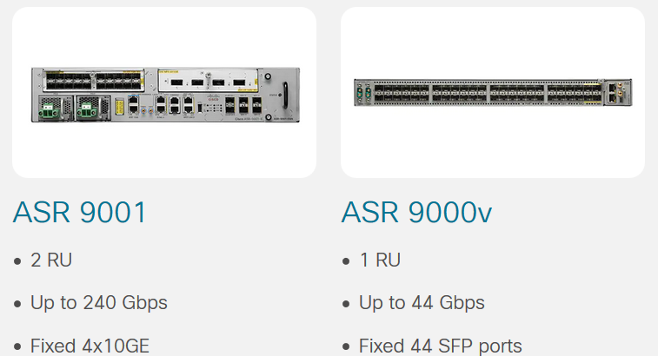
Cisco Certified Technician: CCT
Supporting Cisco Routing & Switching Network Devices
Identifying and working with Cisco Routers and Switches Cisco ASR 9000 Series Routers
The Cisco ASR 9000 Series is designed to simplify and enhance the operational and deployment aspects of service-delivery networks.

Slide 29
Cisco Certified Technician: CCT
Supporting Cisco Routing & Switching Network Devices
Identifying and working with Cisco Routers and Switches Cisco ASR 1000 Series Routers
The Cisco ASR 1000s are engineered for reliability and performance, with industry-leading advancements in silicon, throughput, and security to help your business succeed in a digital world that's always on.

Slide 30
Cisco Certified Technician: CCT
Supporting Cisco Routing & Switching Network Devices
Identifying and working with Cisco Routers and Switches Cisco ASR 1000 Series Routers
The Cisco ASR 1000s are engineered for reliability and performance, with industry-leading advancements in silicon, throughput, and security to help your business succeed in a digital world that's always on.

Slide 31
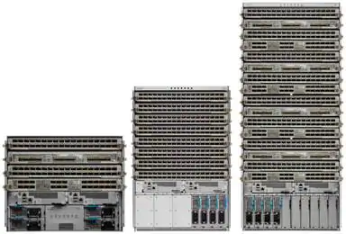
Cisco Certified Technician: CCT
Supporting Cisco Routing & Switching Network Devices
Identifying and working with Cisco Routers and Switches Cisco NCS 5500 Series Routers
The Network Convergence System (NCS) 5500 Series offers industry-leading density of routed 100 GE ports for high-scale WAN aggregation. It is designed to efficiently scale between data centers and large enterprise, web, and service provider WAN and aggregation networks.
Video – Cisco NCS 5500 Series Router Overview

Slide 32
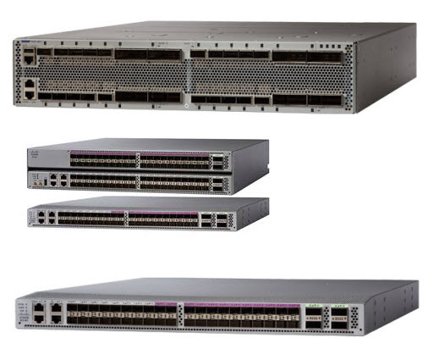
Cisco Certified Technician: CCT
Supporting Cisco Routing & Switching Network Devices
Identifying and working with Cisco Routers and Switches Cisco NCS 5000 Series Routers
A high-density, small-form-factor MPLS aggregation router for metro aggregation and MPLS-enabled data center networks. The Network Convergence System 5000 Series is designed to economically scale large enterprise, over-the-top (OTT), and service provider data center networking architectures.
Video – Cisco NCS 5000 Series Router Overview

Slide 33
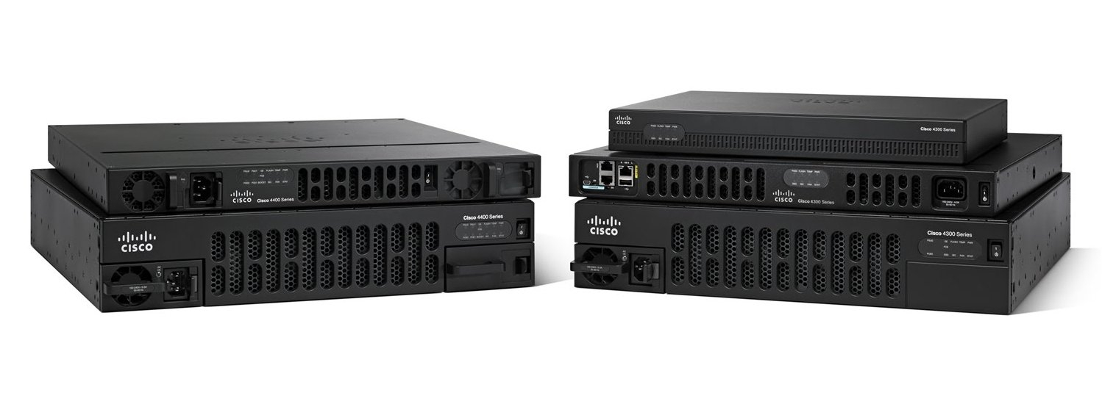
Cisco Certified Technician: CCT
Supporting Cisco Routing & Switching Network Devices
Identifying and working with Cisco Routers and Switches Cisco 4000 Series Routers
The Cisco 4000 Series Integrated Services Routers provide routing, hosting, security, and switching--all in a single, trustworthy platform.
Video – Cisco 4000 Series Router Overview

Slide 34
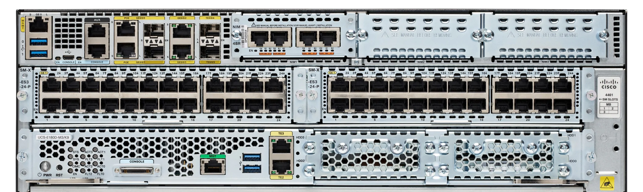
Cisco Certified Technician: CCT
Supporting Cisco Routing & Switching Network Devices
Identifying and working with Cisco Routers and Switches Cisco 4000 Series Routers
The Cisco 4000 Series Integrated Services Routers provide routing, hosting, security, and switching--all in a single, trustworthy platform.

Slide 35
Cisco Certified Technician: CCT
Supporting Cisco Routing & Switching Network Devices
Identifying and working with Cisco Routers and Switches Cisco 1000 Series Routers
Cisco 1000 Series Integrated Services Routers (ISRs) are fixed, high-performance routers that are easy to deploy and manage. Small yet powerful, they provide highly secure broadband, Metro Ethernet, and wireless LAN connectivity.
Video – Cisco 1000 Series Router Overview

Slide 36
Cisco Certified Technician: CCT
Supporting Cisco Routing & Switching Network Devices
Identifying and working with Cisco Routers and Switches Cisco 1000 Series Routers
Cisco 1000 Series Integrated Services Routers (ISRs) with Cisco IOS XE Software combine Internet access, comprehensive security, and wireless services (LTE Advanced 3.0 wireless WAN and 802.11ac wireless LAN) in a single, high-performance device.

Slide 37
Cisco Certified Technician: CCT
Supporting Cisco Routing & Switching Network Devices
Identifying and working with Cisco Routers and Switches Cisco 900 Series Routers
Cisco 900 Series Integrated Services Routers (ISRs) combine WAN, switching, security, and advanced connectivity options in a compact, fanless platform. Create a highly secure, enterprise-class network with a router fit for small and medium-sized businesses.

Slide 38
Cisco Certified Technician: CCT
Supporting Cisco Routing & Switching Network Devices
Identifying and working with Cisco Routers and Switches Cisco 900 Series Routers
The 900 Series offers easy management and provisioning capabilities through Cisco Configuration Professional Express, Cisco DNA Center and Cisco IOS® Software, with full visibility into and control of network configurations and applications.

Slide 39
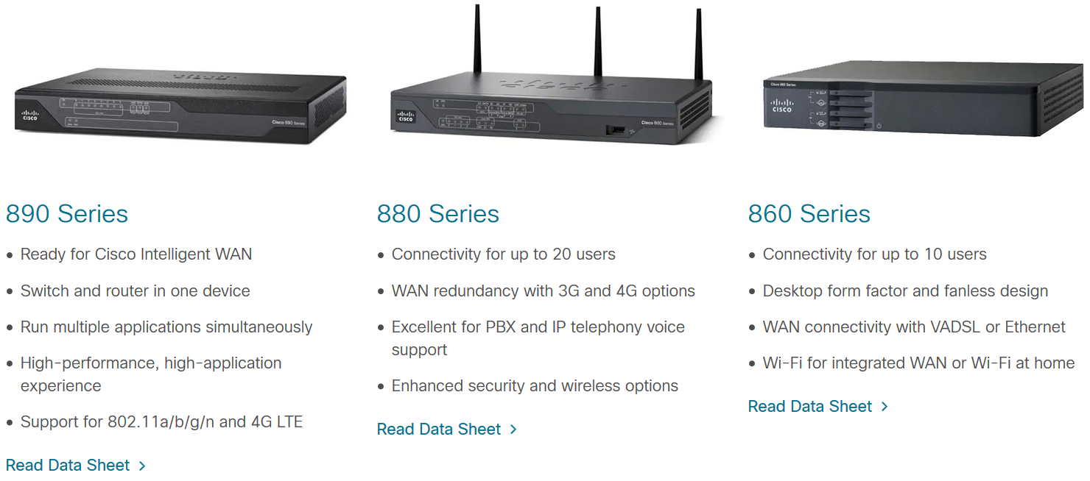
Cisco Certified Technician: CCT
Supporting Cisco Routing & Switching Network Devices
Identifying and working with Cisco Routers and Switches Cisco 800 Series Routers
Do you have limited space, but need best-in-class routing, voice and video, security, application performance, cloud connection, and wireless capabilities? Cisco 800 Series routers offer all that in a single device. They are well suited for customer premises and priced for small and midsize businesses.
Video – Cisco 800 Series Router Overview

Slide 40
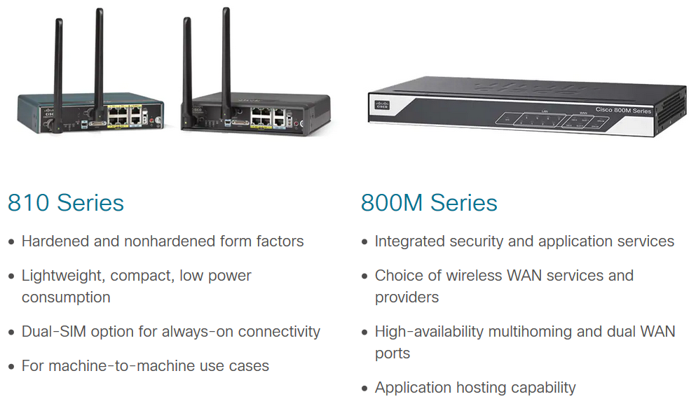
Cisco Certified Technician: CCT
Supporting Cisco Routing & Switching Network Devices
Identifying and working with Cisco Routers and Switches Cisco 800 Series Routers
Do you have limited space, but need best-in-class routing, voice and video, security, application performance, cloud connection, and wireless capabilities? Cisco 800 Series routers offer all that in a single device. They are well suited for customer premises and priced for small and midsize businesses.

Slide 41
CCT Exam Topic 2: Cisco Equipment and Hardware
Cisco Certified Technician: CCT
Supporting Cisco Routing & Switching Network Devices
Section 2.2
Identify Cisco products by logo marking and model number

Slide 42
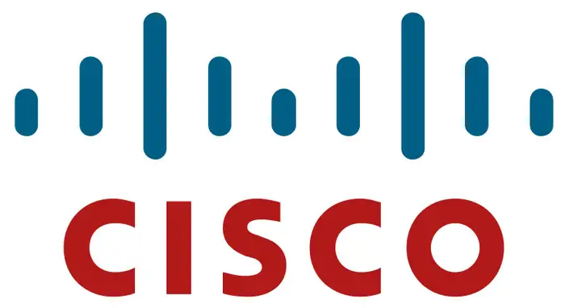
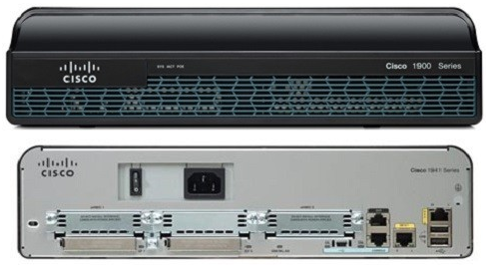
Cisco Certified Technician: CCT
Supporting Cisco Routing & Switching Network Devices
Identify Cisco products by logo marking and model number Cisco Systems Logo
The Cisco corporate logo is an important part of our brand.
It is recognized worldwide.
The use of the logo is protected and my only be used with permission.
There are specific guidelines that govern the use of the logo.
All Cisco products will have the Cisco logo prominently displayed.

Slide 43
Cisco Certified Technician: CCT
Supporting Cisco Routing & Switching Network Devices
Identify Cisco products by logo marking and model number Cisco Systems Unique Device Identifier
The Unique Device Identifier (UDI) is the Cisco Systems product identification standard for hardware products. Cisco strives to provide you with the ability to more effectively integrate and manage evolving Cisco products in your network and business operations.
A product identification standard removes barriers to enterprise automation and can help you reduce operating expenses.

Slide 44
Cisco Certified Technician: CCT
Supporting Cisco Routing & Switching Network Devices
Identify Cisco products by logo marking and model number Cisco Systems Unique Device Identifier

Slide 45
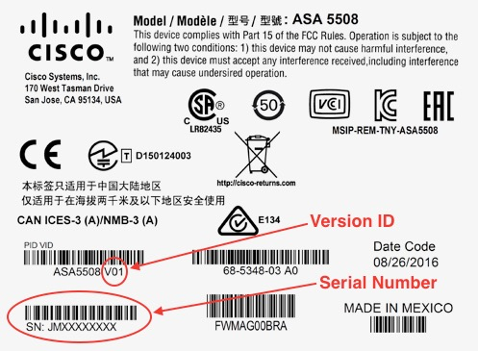
Cisco Certified Technician: CCT
Supporting Cisco Routing & Switching Network Devices
Identify Cisco products by logo marking and model number Cisco Systems Version Visibility
Version Visibility
Cisco continuously improves products through feature additions and bug fixes.
Notable product changes are indicated by incrementing the version ID (VID), which provides version visibility to help you understand and manage product changes.
VID management is automated in engineering and manufacturing tools and processes, ensuring consistency of changes from product to product.
VID changes will be visible on product change notices (PCN) beginning in early 2006.

Slide 46
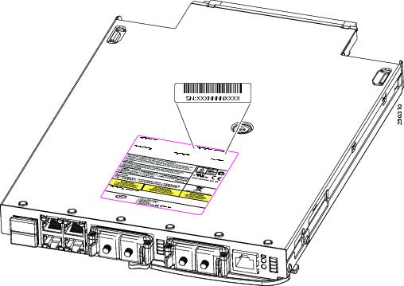
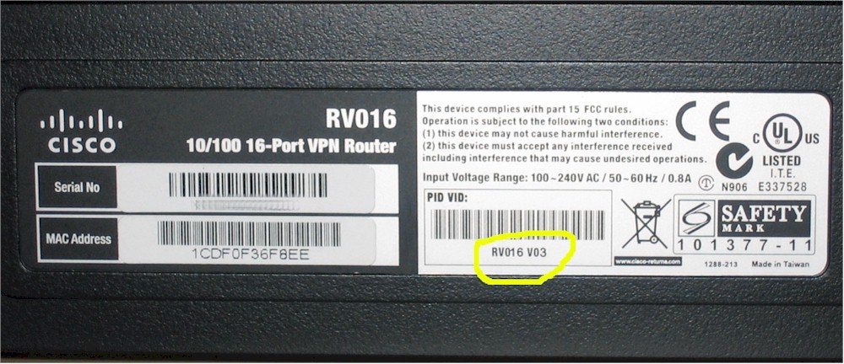
Cisco Certified Technician: CCT
Supporting Cisco Routing & Switching Network Devices
Identify Cisco products by logo marking and model number Cisco Systems Identification
The Cisco model number, serial number, and physical ID appear on a sticker on the outside of the chassis.
Typically the sticker is located on the underside of the device or possibly on the back of the device.
A sticker with similar information will also be located on the boxes the devices are shipped in.

Slide 47
CCT Exam Topic 2: Cisco Equipment and Hardware
Cisco Certified Technician: CCT
Supporting Cisco Routing & Switching Network Devices
Section 2.3
Identify and locate the serial number of Cisco products

Slide 48
Cisco Certified Technician: CCT
Supporting Cisco Routing & Switching Network Devices
Identify Cisco products by logo marking and model number Cisco Product Serial Number
The serial number can be obtained by looking at the rear of the device, it will be a white sticker with black printed letter.
The serial number is also located on the sticker with the model

Slide 49
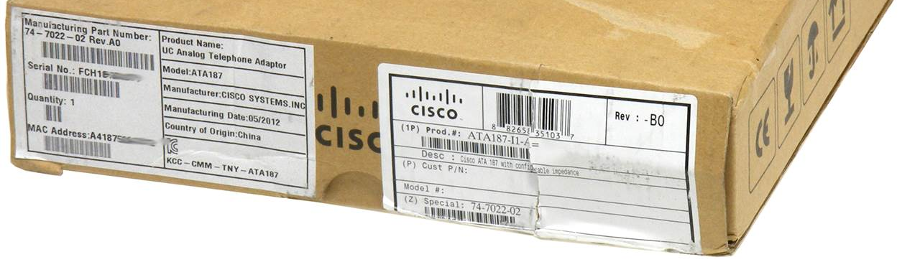
Cisco Certified Technician: CCT
Supporting Cisco Routing & Switching Network Devices
Identify and locate the serial number of Cisco products Cisco Product Serial Number
The device serial number is included in all communications:
Invoices
Shipping notifications
Shipping Labels
Product change notices

Slide 50
Cisco Certified Technician: CCT
Supporting Cisco Routing & Switching Network Devices
Identify Cisco products by logo marking and model number Cisco Product Serial Number
Alternatively from the command line interface on the device, the command "show version" can be entered and look for the serial number in the output.

Slide 51
Cisco Certified Technician: CCT
Supporting Cisco Routing & Switching Network Devices
Identify and locate the serial number of Cisco products Cisco Product Serial Number
The Cisco model number, serial number, and physical ID appear on a sticker on the outside of the chassis.
Typically the sticker is located on the underside of the device or possibly on the back of the device.
A sticker with similar information will also be located on the boxes the devices are shipped in.

Slide 52
CCT Exam Topic 2: Cisco Equipment and Hardware
Cisco Certified Technician: CCT
Supporting Cisco Routing & Switching Network Devices
Section 2.4
Identify and describe the commonly used components

Slide 53
Cisco Certified Technician: CCT
Supporting Cisco Routing & Switching Network Devices
Identify Cisco Equipment and Related Hardware Identify and describe the commonly used components
Many Cisco devices have modular slots in the chassis.
These slots accept a variety of components that enhance the functionality of the device.

Slide 54
CCT Exam Topic 2: Cisco Equipment and Hardware
Cisco Certified Technician: CCT
Supporting Cisco Routing & Switching Network Devices
Section 2.5
Describe the hardware memory common terms and use in Cisco routers and switches

Slide 55
Cisco Certified Technician: CCT
Supporting Cisco Routing & Switching Network Devices
Identify and locate the serial number of Cisco products Describe the hardware memory common terms and use in Cisco routers and switches
NVRAM is non-volatile memory is used as the permanent storage for the startup configuration file (startup-config).
Flash is non-volatile computer memory used as permanent storage for the IOS and other system related files such as log files, voice configuration files, HTML files, backup configurations, and more. When a router is rebooted, the IOS is copied from flash into RAM.
ROM - This non-volatile memory is used to store crucial operational instructions and a limited IOS. Specifically, ROM is firmware embedded on an integrated circuit inside the router which can only be altered by Cisco. Click ROM in the figure to view more information.

Slide 56
CCT Exam Topic 2: Cisco Equipment and Hardware
Cisco Certified Technician: CCT
Supporting Cisco Routing & Switching Network Devices
Section 2.6
Identify the cabling on Cisco equipment
(This topic is covered in Intro to Networks v7 – 4.4.3)

Slide 57
CCT Exam Topic 2: Cisco Equipment and Hardware
Cisco Certified Technician: CCT
Supporting Cisco Routing & Switching Network Devices
Section 2.7
Identify tools for hardware installation and replacement

Slide 58
Cisco Certified Technician: CCT
Supporting Cisco Routing & Switching Network Devices
Service-Related knowledge Use the hardware tools needed for repair
A technician needs to have a good working knowledge of a variety of tools. There are many common tools that are used, such as screwdrivers, flash lights, ladders, and wrenches. However, there are also specialized tools, such as cable testers, loop-back cables, crimping tools, and line toners.

Slide 59
Cisco Certified Technician: CCT
Supporting Cisco Routing & Switching Network Devices
Service-Related knowledge Use the hardware tools needed for repair
Screwdrivers – both Standard, Phillips,
and electronic
Flashlight – hands
free is helpful
Utility knife
Anti-static wrist strap
Crimping tool
Cable tester
Step stool
Cable wraps
Wrench set
Flash card reader and/or USB thumb drive

Slide 60
Cisco Certified Technician: CCT
Supporting Cisco Routing & Switching Network Devices
Service-Related knowledge Use the hardware tools needed for repair
Loopback plugs for different media
Rj-45 coupler
Rj-45 crossover patch cables
Console cable
Rack-mount kits are also needed for various devices to be mounted in standard 19-inch racks

Slide 61
CCT Exam Topic 2: Cisco Equipment and Hardware
Cisco Certified Technician: CCT
Supporting Cisco Routing & Switching Network Devices
Section 2.8
Identify the different loop-back plugs (RJ45 Ethernet, T1, and 56K)

Slide 62
Cisco Certified Technician: CCT
Supporting Cisco Routing & Switching Network Devices
Service-Related knowledge Identify the different loop-back plugs
A loop-back plug is used to test ports (serial, parallel, USB, and network) to find issues.
It allows for simple testing – can be male or female.
It is really just a signal to help diagnose problems.
Examples of loop-back plugs:
Fiber - 2 connectors plugged into the output and input of the gear.
RJ-45 - plug into jack you want to test – if link LED on (ex. switch) is active, then all is good – if not – there is a problem.
Basically you are “tricking” a network card into believing it is plugged into a network for RJ-45.
Also called a “smart-jack.”
Fiber loop-back
Video – How to make a loopback plug
RJ-45 loopback showing 1 to 3 and 2 to 6

Slide 63
Cisco Certified Technician: CCT

