Slide 1
EARLY CHILDHOOD DATA SYSTEM (ECDS) Presented by: Stephanie Smelley

Slide 2
Note
The focus of this presentation is on the changes for the official XML data submissions during the 2023-2024 school year.

Slide 3
Agenda
ECDS
Program Area Updates and Guidance
2023-2024
Application Updates
Data Element Updates
Code Table Updates
Report Updates
Business Rule Updates
Timeline
Frequently Asked Questions
Technical Resources
Questions

Slide 4
Program Area Updates & Guidance
ECDS Kindergarten Assessment Guidance
Ensure student information is loaded timely
ECDS Prekindergarten Assessment Update
Current Commissioner's list has been extended through SY 23-24
High-Quality Prekindergarten Update
Update on the changes made in the ECDS reporting
FAMILY-ENGAGEMENT-PLAN-LINK (E1583) definition and data element reporting requirements
PROGRAM-EVALUATION-TYPE (E1626) definition and moved from Section level to LEA level
PK-SCHOOL-TYPE (E1555) definition
CHILD-CARE-OPERATION-NUMBER (E1726) definition and moved from LEA level to Course Section level
* Updated since Spring 2023 training

Slide 5
PK School Type Code Table
Code | Description
01 Non-Public Pre-K Head Start ​ | would be reported for a standalone Head Start not associated with a school district.​
02 Public Pre-K ​ | would be reported for public school programs implementing prekindergarten programs (excluding partnerships).​
05 Non-Public Pre-K Licensed Child Care ​ | would be reported for standalone childcare providers not associated with a school district.​
07 Public Pre-K Head Start ​ (LEA Grantee) | would be reported for public prekindergarten Head Start classrooms where the LEA is the Head Start grantee. (This school type code will NOT require the LEA to submit a Child Care Operation Number.)
08 Public Pre-K Licensed Child Care ​ | would be reported for public prekindergarten programs that partner directly with a licensed childcare provider to dually enroll students (includes partnership classrooms where children are dually enrolled in both the LEA and childcare provider site). (This school type code WILL require the LEA to submit a Child Care Operation Number.)​
10 Non-Public Pre-K ​ | would be reported for private prekindergarten providers not associated with a school district.​
11 In-District Charter Partnership ​ | would be reported for prekindergarten programs that are operated through an in-district charter partnership. The board of the LEA has authorized a non-profit organization, government entity, institute of higher education, and/or an existing charter as an in-district charter.​ (This school type code WILL require the LEA to submit a Child Care Operation Number.)​
12 Public Pre-K Head Start (Non-LEA Grantee) | would be reported for public prekindergarten programs that partner with a Head Start program and the Head Start grantee is not an LEA. (This school type code WILL require the LEA to submit a Child Care Operation Number.)​
99 Other ​ | would be reported when any of the codes do not describe the program.​
* New slide since Spring 2023 training

Slide 6
2023-2024

Slide 7
Application Updates
No application updates are currently scheduled for the 2023-2024 school year.

Slide 8
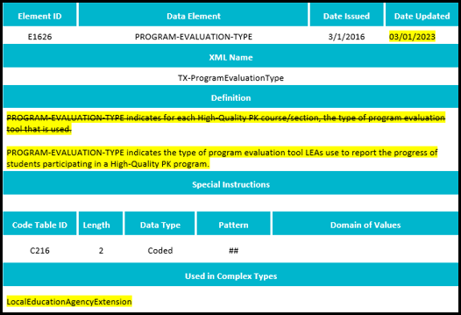
Data Element Updates
Updated the definition for PROGRAM-EVALUATION-TYPE (E1626).

Slide 9
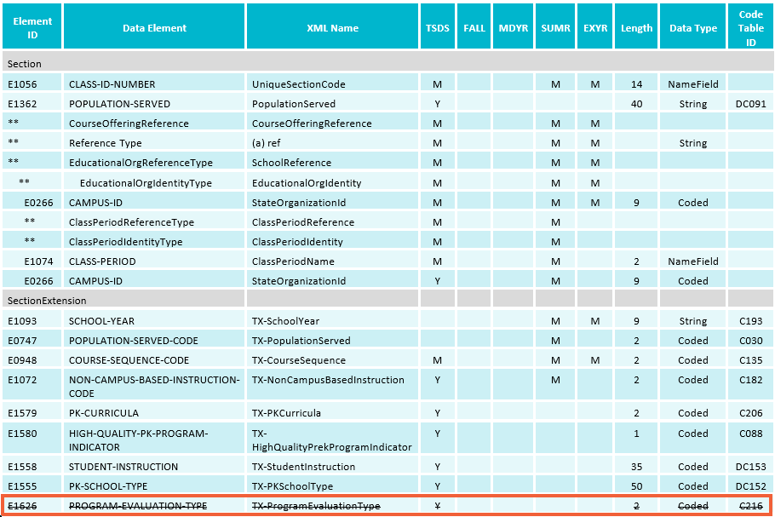
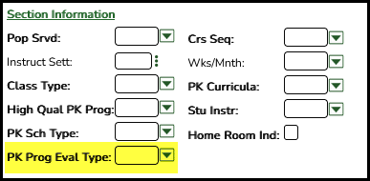
Data Element Updates - 1
Deleted PROGRAM-EVALUATION-TYPE (E1626) from the SectionExtension complex type.

Slide 10
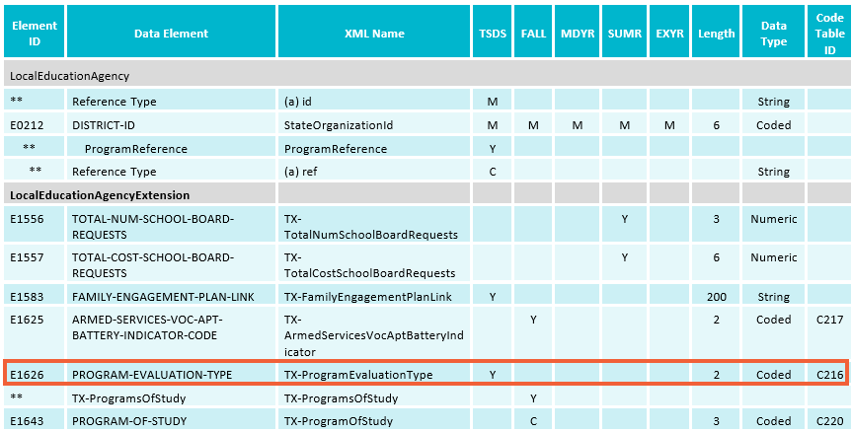
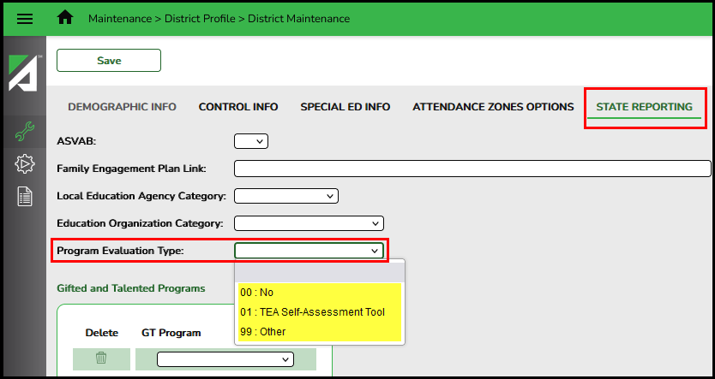
Data Element Updates - 2
Added the existing PROGRAM-EVALUATION-TYPE (E1626) to the LocalEducationAgencyExtension complex type.

Slide 11
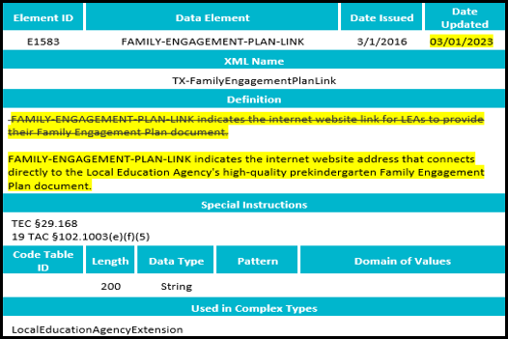
Data Element Updates - 3
Updated the definition for FAMILY-ENGAGEMENT-PLAN-LINK (E1583).

Slide 12
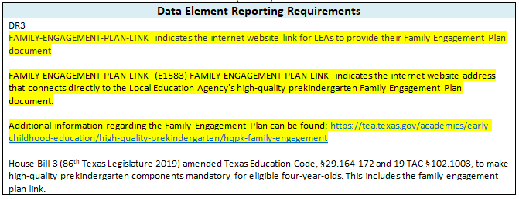
Data Element Updates - 4
Updated the data element reporting requirements in the LocalEducationAgencyExtension for the FAMILY-ENGAGEMENT-PLAN-LINK (E1583).

Slide 13
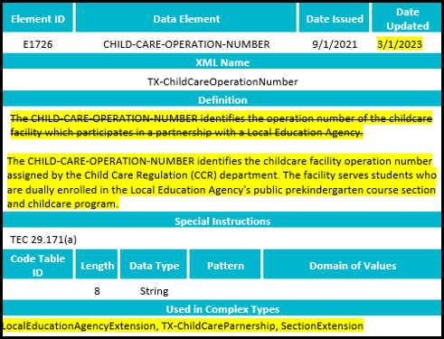
Data Element Updates - 5
Updated the definition for CHILD-CARE-OPERATION-NUMBER (E1726).

Slide 14
Data Element Updates - 6
Deleted the sub-complex, TX-ChildCarePartnership, and the included CHILD-CARE-OPERATION-NUMBER (E1726) from the LocalEducationAgencyExtension complex type.

Slide 15
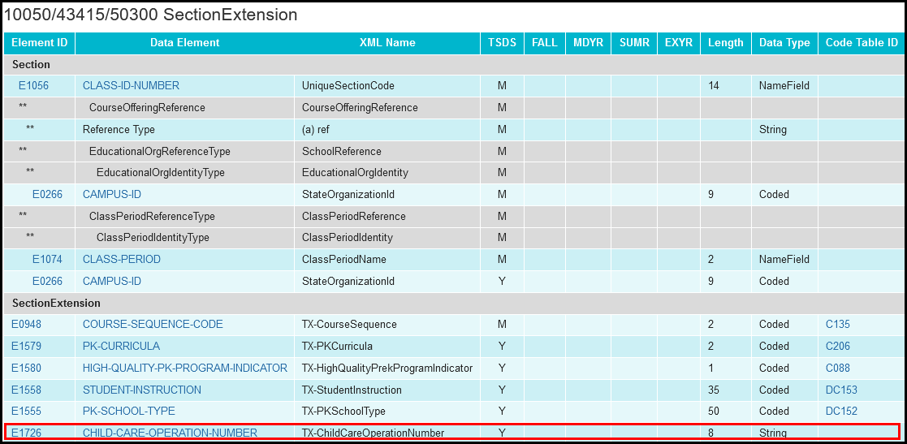
Data Element Updates - 7
Added the CHILD-CARE-OPERATION-NUMBER (E1726) to the SectionExtension complex type to be reported as optional.

Slide 16
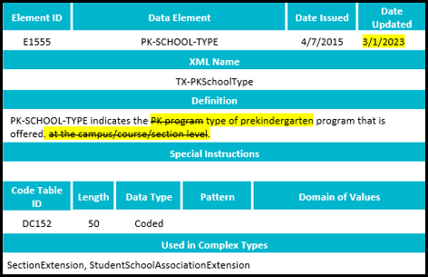
Data Element Updates - 8
Updated the definition for the PK-SCHOOL-TYPE (E1555).

Slide 17
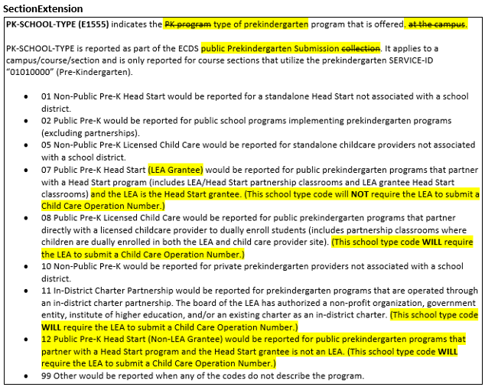
Data Element Updates - 9
Updated the data element reporting requirements for the PK-SCHOOL-TYPE (E1555) in the SectionExtension complex type.

Slide 18
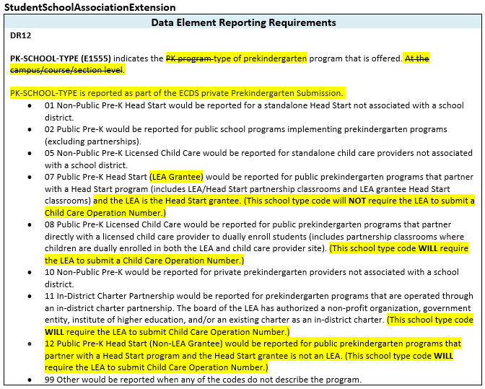
Data Element Updates - 10
Updated the data element reporting requirements for the PK-SCHOOL-TYPE (E1555) in the StudentSchoolAssociationExtension complex type.

Slide 19
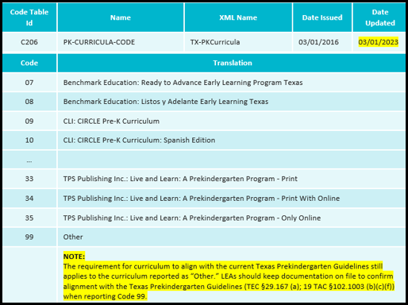
Code Table Updates
Added additional guidance to the PK-CURRICULA-CODE (C206) code table when an LEA reports "99-Other."

Slide 20
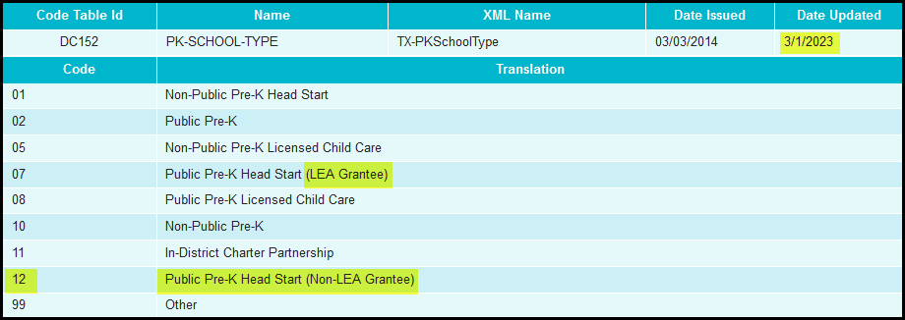
Code Table Updates - 1
Updated the code translation for “07 - Public Pre-K Head Start” to “Public Pre-K Head Start (LEA Grantee)” in the PK-SCHOOL-TYPE (DC152) code table.
Added new code and translation “12 - Public Pre-K Head Start (Non-LEA Grantee)” to PK-SCHOOL-TYPE (DC152) code table.

Slide 21
Report Updates
The following reports will be updated to add/remove rows/columns for the previously mentioned data element updates:
ECD0-000-006 TSDS Early Childhood PK Data Submission
ECD0-000-007 TSDS Early Childhood PK Completion
ECD0-000-010 TSDS Early Childhood High Quality PK Component Completion
* Updated slide since Spring 2023 training

Slide 22
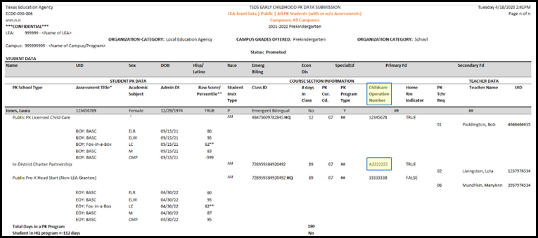
Report Updates
ECD0-000-006 TSDS Early Childhood PK Data Submission report updates:
E1726 CHILD-CARE-OPERATION-NUMBER
* New slide since Spring 2023 training

Slide 23
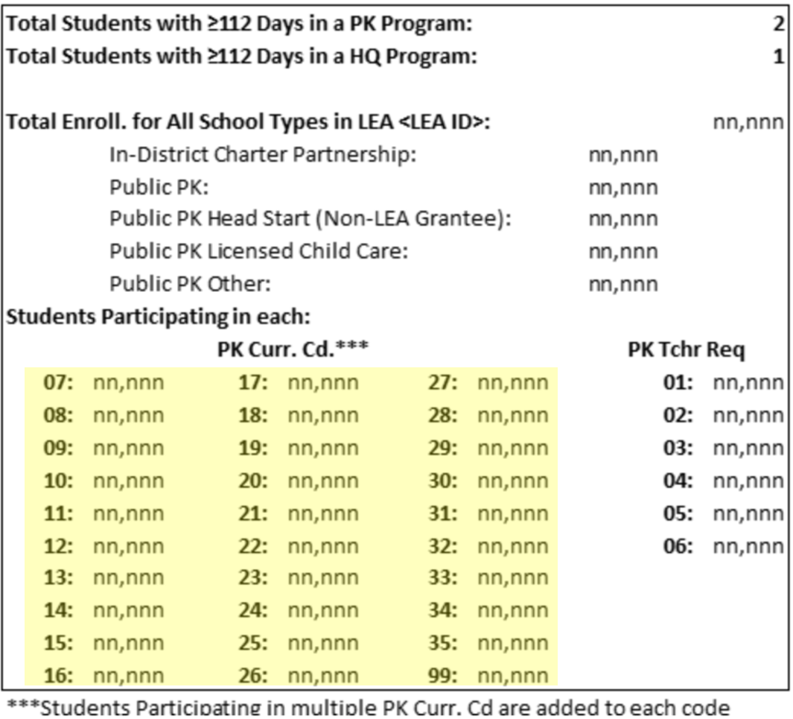
Report Updates
ECD0-000-006 TSDS Early Childhood PK Data Submission report updates:
C206 PK-CURRICULA-CODE
* New slide since Spring 2023 training

Slide 24
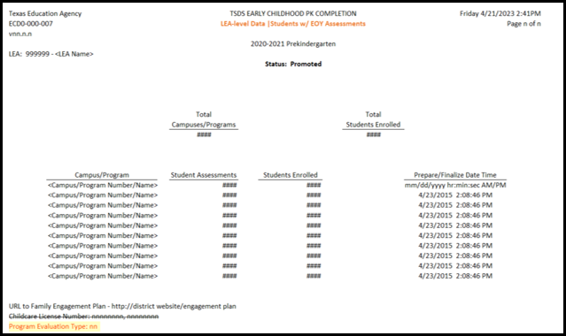
Report Updates
ECD0-000-007 TSDS Early Childhood PK Completion updates:
C216 PROGRAM-EVALUATION-TYPE-CODE
* New slide since Spring 2023 training

Slide 25
Report Updates
ECD0-000-010 TSDS Early Childhood High Quality PK Component Completion updates:
C216 PROGRAM-EVALUATION-TYPE-CODE
* New slide since Spring 2023 training

Slide 26
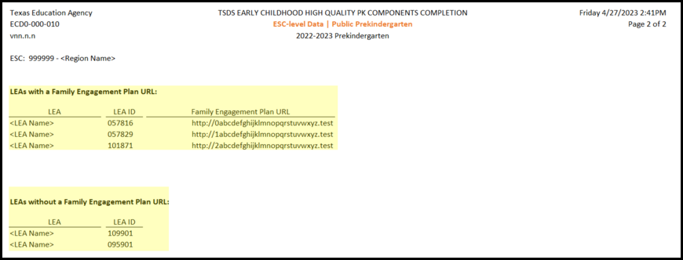
Report Updates
ECD0-000-010 TSDS Early Childhood High Quality PK Component Completion updates:
E1583 FAMILY-ENGAGEMENT-PLAN-LINK
* New slide since Spring 2023 training

Slide 27
Business Rule Updates
New business rule for E1626 PROGRAM-EVALUATION-TYPE
Updated business rule 10050-0002 to remove reference to PROGRAM-EVALUATION-TYPE.

Slide 28
Business Rule Updates - 1
Deleted business rule 10010-0021.

Slide 29
Business Rule Updates - 2
New business rule 10050-0005 for reference to PK-SCHOOL-TYPE (DC152) and CHILD-CARE-OPERATION-NUMBER (E1726)

Slide 30
Business Rule Updates - 3
Updated business rule 10050-0004 for reference to PK-SCHOOL-TYPE (DC152) and CHILD-CARE-OPERATION-NUMBER (E1726).

Slide 31
Business Rule Updates - 4
Updated business rule 10050-0001 for reference to FAMILY-ENGAGEMENT-PLAN-LINK (E1583).

Slide 32
Timeline

Slide 33
Timeline - 1

Slide 34
Frequently Asked Questions
Are LEAs required to enter a Child Care Operation Number when reporting PK-SCHOOL-TYPE (E1555)?
Yes, LEAs are required to enter a Child Care Operation Number when reporting PK-SCHOOL-TYPE codes:
08 Public Pre-K Licensed Child Care
11 In-District Charter Partnership
12 Public Pre-K Head Start (Non-LEA Grantee)
LEAs will now receive a “Fatal” error if a Child Care Operation Number is not provided but is required when reporting certain PK-SCHOOL-TYPE code values.

Slide 35
Frequently Asked Questions
When will the Early Childhood Data System (ECDS) assessment vendors start sending assessment data to TEA?
The ECDS KG assessment vendors, Children’s Learning Institute (CLI) (Monday – Friday) and Amplify (twice a week), will begin sending assessment data to TEA in November 2023. LEAs can then load the assessment data into the ODS using the “Load Assessments” button.

Slide 36
Frequently Asked Questions
Does the LEA reopen the ECDS KG Submission to add a new student if the student enrolls after the LEA completes the testing window?
If a new KG student enrolls in the LEA and is assessed with a Commissioner’s approved KG assessment, then the LEA should reopen the ECDS KG Submission by using the “Reset” button in the ECDS Application and promote the KG student data. If the student enrolls after the LEAs testing window, then the KG student would not need to be reported as part of the ECDS KG Submission.

Slide 37
Frequently Asked Questions
Is there any Average Daily Attendance (ADA) funding related to how an LEA reports PK-SCHOOL-TYPE?
There is no additional funding associated with how LEAs report PK-SCHOOL-TYPE. The Texas Workforce Commission’s only funding is to support the creation of Childcare Partnerships. ADA is associated to the eligibility for PK and attendance.

Slide 38
Frequently Asked Questions
When loading KG assessments from the ECDS application it shows that it loaded in the ODS, but when I go into the ODS batch uploads why do I not see the Student Assessment file?
LEAs should check the File Manager in the ODS to see if the StudentAssessment or AssessmentMetadata xml files are showing an error that prevented them from being batched into the ODS uploads.

Slide 39
Frequently Asked Questions - 1
Should Local Education Agencies (LEAs) report all prekindergarten (PK) and kindergarten (KG) students enrolled at any time before the Early Childhood Data System (ECDS) Collections, even if they are not assessed?
LEAs should report all KG and PK students in their respective ECDS Collections that were enrolled at any time before the collection due date, regardless if the student was assessed. In addition, LEAs should be verifying through their business validations and reports if a KG or PK student that is reported should have a TEA Commissioner approved assessment. For the ECDS KG and PK submissions all students that are promoted will show on the ECD0-000- 004 KG Data Submission Report or ECD0-000-006 PK Data Submission Report. Those KG students that are submitted without an assessment will display demographics, course/section, special programs information and show as ‘Not Assessed’ for their assessment information on the report. Those PK students that are submitted without an assessment will display demographics, course/section, special programs information and show as ‘Null’ for their assessment information. In addition, a special warning business validation should also be triggered indicating the ECDS KG or PK student should have assessment data information reported.

Slide 40
Technical Resources
Technical Specifications:
Texas Education Data Standards (TEDS)
Technical Support:
TSDSCustomerSupport@tea.texas.gov
ECDS Program Area:
Early Childhood Education Website
Early Childhood Education Division Support Portal
Knowledge Base Articles:
TSDSKB-249 ECDS: General FAQs
TSDSKB-508 ECDS: Assessment Specifications

Slide 41
Questions?
Thank you for attending.

