Slide 1
TSDS CORE COLLECTIONS ESC Region 11 Fall Conference September 20, 2024

Slide 2
AGENDA – CORE COLLECTIONS
CHARTER SCHOOL WAITLIST (CSW)
RESIDENTIAL FACILITY TRACKER (RFT)
SPPI-14
CLASS ROSTER WINTER (CRW)
SPECIAL EDUCATION LANGUAGE ACQUISITION (SELA)
CHILD FIND (CF)

Slide 3
TITLE SLIDE: ESC Vendor Training for One Component
CHARTER SCHOOL WAITLIST (CSW)

Slide 4
CHARTER SCHOOL WAITLIST (CSW) TIMELINE

Slide 5
APPLICATION UPDATES
No application updates for the following:
Data Elements
Descriptor Tables
Reports
Business Rules

Slide 6
TSDS UPGRADE PROJECT UPDATES
Data Element Name Changes:
None

Slide 7
TSDS UPGRADE PROJECT UPDATES
Business Rule Changes:
Revised Data Validation Rule 40100-0238:

Slide 8
TSDS UPGRADE PROJECT UPDATES
Business Rule Changes:
Deleted Data Validation Rule 40100-0236
This rule was deleted, as it will be caught by the L1 API errors in the TSDS Upgrade Project.

Slide 9
TSDS UPGRADE PROJECT UPDATES
Business Rule Changes:
Deleted Data Validation Rule 40100-0237
This rule was deleted, as it will be caught by the L1 API errors in the TSDS Upgrade Project.

Slide 10
FREQUENTLY ASKED QUESTIONS
Does the charter school need to complete this data collection if they do not have a waitlist, and they are not at capacity?
Yes, all open enrollment charter schools must complete the CSW collection. If they are not at capacity and do not have a waitlist, they still must submit the following Education Organization data:
E1674 NumberCharterStudentsEnrolled
E1675 CharterEducationalEnrollmentCapacity
E1676 CharterAdmissionWaitlist

Slide 11
FREQUENTLY ASKED QUESTIONS
What value should be entered for the CharterEducationalEnrollmentCapacity (E1675) if there are not students currently enrolled at the campus?
The charter school should report the value as defined in TEDS which is “the number of students to which the charter school campus is able to provide instruction without exceeding staffing and facility limitations and the approved charter holder’s maximum enrollment.” The value must be greater that zero (0).

Slide 12
FREQUENTLY ASKED QUESTIONS
Our charter school uses a third-party vendor that will be publishing the Charter School Waitlist (CSW) submission data in our IODS. Does TEA provide a claim set for CSW vendors?
At this time, TEA does not provide a claim set for CSW vendors. Charter schools using a third-party vendor that will be publishing the CSW submission data in the IODS will need to create a custom claim set for their vendor. Please enter a TIMS ticket for assistance if needed when creating a custom claim set.

Slide 13
TITLE SLIDE: ESC Vendor Training for One Component
RESIDENTIAL FACILITY TRACKER (RFT)

Slide 14
RESIDENTIAL FACILITY TRACKING (RFT) TIMELINE

Slide 15
DATA GOVERNANCE UPDATES
No updates to the following since TSDS Spring training:
Data Elements
Descriptor Tables
Reports
Business Rules

Slide 16
TSDS UPGRADE PROJECT UPDATES
Data Element Name Changes:
Data Element ID | XML Data Element Name | Upgrade Data Element Name
E0041 | PRIMARY-DISABILITY-CODE | Disability
E0834 | SECONDARY-DISABILITY-CODE | Disability
E0835 | TERTIARY-DISABILITY-CODE | Disability

Slide 17
TSDS UPGRADE PROJECT UPDATES
Data Element Name Changes:
Data Element ID | XML Data Element Name | Upgrade Data Element Name
E0833 | REG-DAY-SCH-PROG-DEAF-CODE | SpecialEducationProgramService
E0838 | AUDIOLOGICAL-SERV-IND-CODE | SpecialEducationProgramService
E0840 | COUNSELING-SERVICES-IND-CODE | SpecialEducationProgramService
E0841 | MEDICAL-DIAGNOSTIC-SERV-IND-CODE | SpecialEducationProgramService
E0843 | OCCUPATIONAL-THERAPY-IND-CODE | SpecialEducationProgramService

Slide 18
TSDS UPGRADE PROJECT UPDATES
Data Element Name Changes:
Data Element ID | XML Data Element Name | Upgrade Data Element Name
E0844 | ORIENT-MOBILITY-TRNG-IND-CODE | SpecialEducationProgramService
E0845 | PHYSICAL-THERAPY-IND-CODE | SpecialEducationProgramService
E0846 | PSYCHOLOGICAL-SERVICES-IND-CODE | SpecialEducationProgramService
E0847 | RECREATION-IND-CODE | SpecialEducationProgramService

Slide 19
TSDS UPGRADE PROJECT UPDATES
Data Element Name Changes:
Data Element ID | XML Data Element Name | Upgrade Data Element Name
E0848 | SCHOOL-HEALTH-SERVICES-IND-CODE | SpecialEducationProgramService
E0849 | SOCIAL-WORK-SERVICES-IND-CODE | SpecialEducationProgramService
E0851 | TRANSPORTATION-INDICATOR-CODE | SpecialEducationProgramService
E0857 | SPEECH-THERAPY-INDICATOR-CODE | SpecialEducationProgramService

Slide 20
TSDS UPGRADE PROJECT UPDATES
Data Element Name Changes:
Data Element ID | XML Data Element Name | Upgrade Data Element Name
E0899 | PRESCHL-PROG-CHLDRN-WITH-DISAB-IND-CD | SpecialEducationProgramService
E0900 | EARLY-CHILDHOOD-INTERV-IND-CODE | SpecialEducationProgramService
E0997 | ASSISTIVE-TECH-INDICATOR-CODE | SpecialEducationProgramService
E1040 | INTERPRETING-SERVICES-TYPE-CODE | SpecialEducationProgramService

Slide 21
TSDS UPGRADE PROJECT UPDATES
Business Rule Changes:
If Disability is "14", then OrderOfDisability must be 1.
For 2023-2024 the disability data elements were primary, secondary, and tertiary.
For 2024-2025, the OrderOfDisability is used, 1=primary, 2=secondary, and 3=tertiary.

Slide 22
TSDS UPGRADE PROJECT UPDATES
Business Rule Changes:
On the PEIMS Fall snapshot date, or on the submission date for the Residential Facility Tracker (RFT) collection, if a Disability is reported with OrderOfDisability 3, then a Disability must be reported with OrderOfDisability of 2 for this student.
For 2023-2024 the disability data elements were primary, secondary, and tertiary.
For 2024-2025, the OrderOfDisability is used, 1=primary, 2=secondary, and 3=tertiary.

Slide 23
TSDS UPGRADE PROJECT UPDATES
Business Rule Changes:
On the submission date for the Residential Facility Tracker (RFT) submission, if a Disability is reported with OrderOfDisability of 2 or 3, then a Disability must be reported with OrderOfDisability of 1.
For 2023-2024 the disability data elements were primary, secondary, and tertiary.
For 2024-2025, the OrderOfDisability is used, 1=primary, 2=secondary, and 3=tertiary.

Slide 24
TSDS UPGRADE PROJECT UPDATES
NEW Business Rule Changes:
Reinstated Data Validation Rule 10025-0001:

Slide 25
TSDS UPGRADE PROJECT UPDATES
NEW Business Rule Changes:
Added Data Validation Rule 40115-0013:

Slide 26
TSDS UPGRADE PROJECT UPDATES
NEW Business Rule Changes:
Revised Data Validation Rule 41163-0010:

Slide 27
TSDS UPGRADE PROJECT UPDATES
NEW Business Rule Changes:
Added Data Validation Rule 41163-0103:

Slide 28
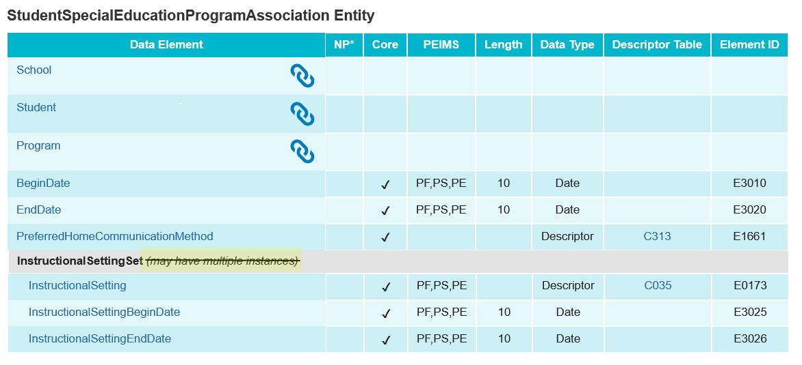
TSDS UPGRADE PROJECT UPDATES
NEW Entity/Common Type Change:
StudentSpecialEducationProgramAssociation.InstructionalSettingSet
Removed may have multiple instances

Slide 29
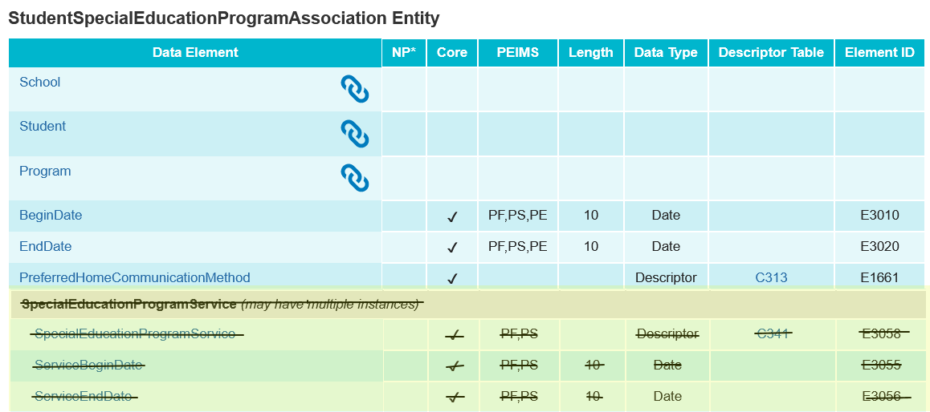
TSDS UPGRADE PROJECT UPDATES
NEW Entity/Common Type Change:
Removed SpecialEducationProgramService common type

Slide 30
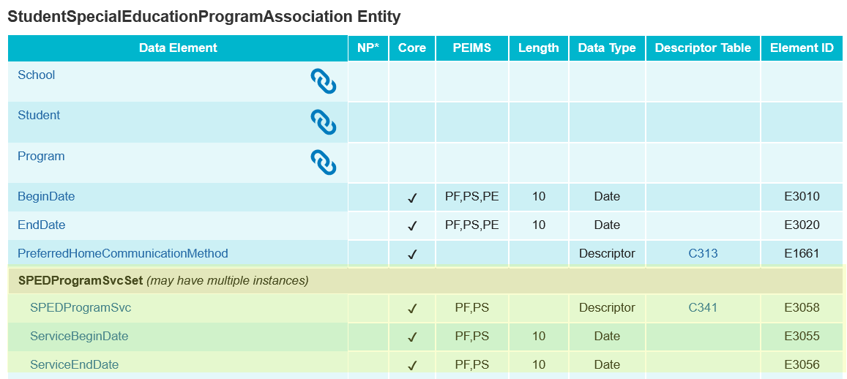
TSDS UPGRADE PROJECT UPDATES
NEW Entity/Common Type Change:
StudentSpecialEducationProgramAssociation.SPEDProgramSvcSet

Slide 31
TSDS UPGRADE PROJECT UPDATES
Additional Changes:
Legacy Data Element | Legacy Complex Type | Upgrade Data Element | Upgrade Student Entity
CAMPUS-ID-OF-ENROLLMENT (E0782) | StudentResidentialFacilityAssociationExtension Complex Type | School | StudentSchoolAssociation
ENTRY-GRADE-LEVEL-TYPE (E1517) | StudentResidentialFacilityAssociationExtension Complex Type | EntryGradeLevel | StudentSchoolAssociation

Slide 32
TITLE SLIDE: ESC Vendor Training for One Component
STATE PERFORMANCE PLAN INDICATOR (SPPI-14)

Slide 33
STATE PERFORMANCE PLAN INDICATOR (SPPI-14) TIMELINE

Slide 34
APPLICATION UPDATES
No application updates for the following:
Data Elements
Descriptor Tables
Reports
Business Rules

Slide 35
TSDS UPGRADE PROJECT UPDATES
Data Element Name Changes:
Data Element ID | XML Data Element Name | Upgrade Data Element Name
E3033 (was E0895) | HOME-LANGUAGE-CODE | Language
E1001 | LEAVER-REASON-CODE | ExitWithdrawType

Slide 36
TSDS UPGRADE PROJECT UPDATES
Business Rule Changes:
Rule text has been updated to reflect the change in the data element name.

Slide 37
TSDS UPGRADE PROJECT UPDATES
Business Rule Changes:
DATE-OF-BIRTH must be a valid date.
This rule was deleted, as it will be caught by the L1 API errors in the TSDS Upgrade Project.

Slide 38
TSDS UPGRADE PROJECT UPDATES
Business Rule Changes:
Added new business rule
If CONTACT-PRIORITY is not blank, then it must not match CONTACT-PRIORITY for any other parents associated with this student.

Slide 39
FREQUENTLY ASKED QUESTIONS
How does SPPI-14 determine if a student was identified as special education in the prior school year?
The SPPI-14 promotion logic determines if a student was identified as special education by looking at data reported in the PEIMS Fall or Summer in the prior school year. Students reported with SPECIAL-ED-INDICATOR-CODE (E0794) = ‘1’ in either collection are considered for SPPI-14.

Slide 40
FREQUENTLY ASKED QUESTIONS
Why is the number of records that promote to the Parent>Parent Basic Information subcategory more than the number of parents that display on the SPP0-000-001 TSDS SPPI-14 Student Roster Report?
The SPP0-000-001 report will only display up to two parent contact records per student based on the two reported with the lowest value for the ContactPriority (E1427) data element. However, the SPPI-14 promotion logic will promote all parent contacts populated in the IODS for an individual student which could be more than the two listed on the report.

Slide 41
FREQUENTLY ASKED QUESTIONS
Which values for the ExitWithdraw Type (E1001) data element must the student be reported with for the student to promote to SPPI-14?
A student must be reported with one of the following ExitWithdraw Types in the PriorYearLeaver entity to promote to SPPI-14:
01- Graduated from a campus in the district or charter
24 – College, Pursue Associate’s or Bachelor’s Degree
88 – Court-ordered to a TxCHSE program, has not earned a TxCHSE
90 – Grad other state Interstate Compact on Edu Opportunity for Military Child
98 - Other

Slide 42
TITLE SLIDE: ESC Vendor Training for One Component
CLASS ROSTER WINTER (CRW)

Slide 43
CLASS ROSTER WINTER (CRW) TIMELINE

Slide 44
DATA GOVERNANCE UPDATES
No updates to the following since TSDS Spring training:
Report Updates
Data Elements
Descriptor Tables
Business Rules

Slide 45
DATA ELEMENT UPDATES
Data elements deleted:
Data Element ID | XML Data Element Name | Upgrade Data Element Name
E1074 | CLASS-PERIOD | N/A
E1088 | STAFF-IDENTIFICATION-SYSTEM-TYPE | N/A

Slide 46
DESCRIPTOR TABLE UPDATES
Descriptor table deleted:
Descriptor ID | XML Code Table Name | Upgrade Descriptor Name
C191 | STAFF IDENTIFICATION-SYSTEM-TYPE | N/A

Slide 47
BUSINESS RULE UPDATES
Deleted Rule:
Uses STAFF-IDENTIFICATION-SYSTEM-TYPE which is not used in TSDS Upgrade Project.
30040-0029

Slide 48
TSDS UPGRADE PROJECT UPDATES
Data Element Name Changes:
Data Element ID | XML Data Element Name | Upgrade Data Element Name
E3010 (was E1069) | STUDENT-BEGIN-DATE | BeginDate
E3020 (was E1070) | STUDENT-END-DATE | EndDate
E3010 (was E1065) | ASSIGNMENT-BEGIN-DATE | BeginDate
E3020 (was E1066) | ASSIGNMENT-END-DATE | EndDate

Slide 49
TSDS UPGRADE PROJECT UPDATES
Business Rule Changes:
Uses ‘CourseCode’ descriptor values replacing ‘SERVICE-ID’

Slide 50
TSDS UPGRADE PROJECT UPDATES
Business Rule Changes:
Uses ‘Classroom Position’ descriptor values instead of ‘ROLE-ID’ codes:

Slide 51
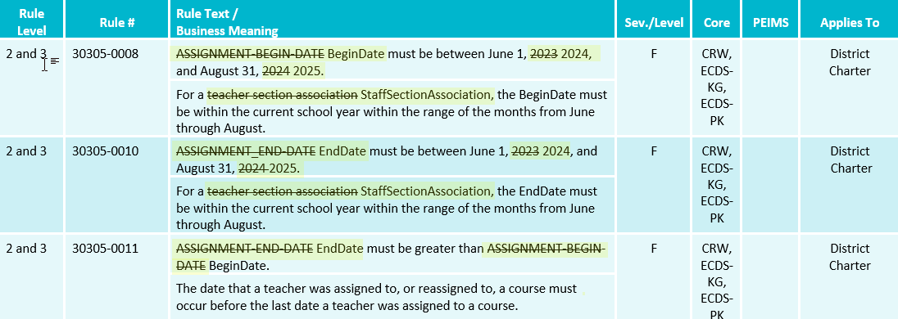
TSDS UPGRADE PROJECT UPDATES
Business Rule Changes:
Uses BeginDate and EndDate:

Slide 52
FREQUENTLY ASKED QUESTIONS
How should an LEA proceed if their vendors are overwriting Staff entity data that contain Class Roster Winter Submission data elements such as TeacherIncentiveAllotment?
An LEA encountering this issue can configure the IODS read/write access through the DMC. When creating or editing an existing application, the LEA should select the appropriate Profile under the ‘Advance Security Options’. Once configured, the LEA can set the appropriate access for the following:
E1722 TeacherIncentiveAllotmentDesignation
E1721 CreditableYearOfService
E1581 PKTeacherRequirement
E1673 AdditionalDaysProgramTeacher

Slide 53
TITLE SLIDE: ESC Vendor Training for One Component
Special Education Language Acquisition (SELA)

Slide 54
SPECIAL EDUCATION LANGUAGE ACQUISITION (SELA)TIMELINE

Slide 55
APPLICATION UPDATES
No application updates for the following:
Data Elements
Reports
Business Rules

Slide 56
TSDS UPGRADE PROJECT UPDATES
Descriptor Table Updates:

Slide 57
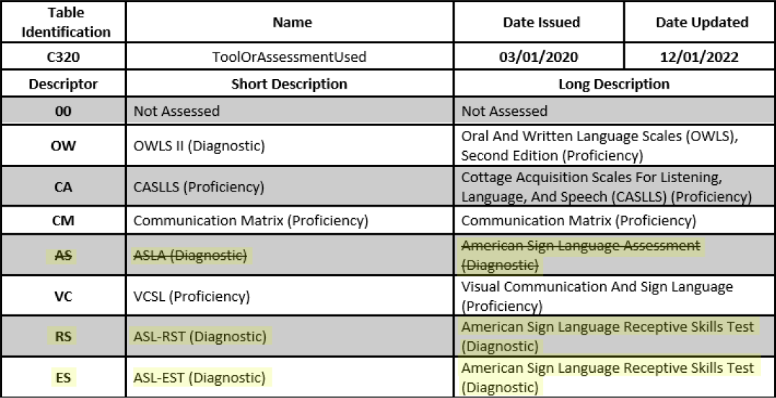
TSDS UPGRADE PROJECT UPDATES
Descriptor Table Updates:

Slide 58
TSDS UPGRADE PROJECT UPDATES
Data Element Name Changes:
Data Element ID | XML Data Element Name | Upgrade Data Element Name
E3010 | N/A | BeginDate
E3020 | N/A | EndDate
E3016 | N/A | DisabilitySetBeginDate
E3017 | N/A | DisabilitySetEndDate
E3025 | N/A | InstructionalSettingBeginDate
E3026 | N/A | InstructionalSettingEndDate
E0266 | CAMPUS-ID | EducationOrganization (Reference)

Slide 59
TSDS UPGRADE PROJECT UPDATES
Descriptor Table Name Changes:
Descriptor Table ID | XML Code Table Name | Upgrade Descriptor Table Name
C061 (was DC079) | EMERGENT-BILINGUAL-TYPE | EmergentBilingualIndicator
C318 (was DC160) | PERIOD-OF-TIME-ACCESS-CODE | HearingAmplificationAccess
C319 (was DC161) | AVERAGE-TIME-CODE | HearingAmplificationDailyUse
C303 (was DC096) | PROGRAM-TYPE | ProgramType
C053 (was DC142) | DISABILITY-TYPE | Disability
Notes:
DC096 PROGRAM-TYPE->C303 ProgramType:
C303 now only includes the following values:
04 Bilingual
05 Career and Technical Education
12 English as a Second Language (ESL)
33 Special Education
38 Title I Part A
DC142 DISABILITY TYPE->C053 Disability
C053 descriptor value updates (description reassigned to new code values)
01-Orthopedic Impairment
02-Other Health Impairment
03-Deaf And Hard Of Hearing
04-Deaf And Hard Of Hearing
05-Deaf-Blindness
06-Intellectual Disability
07-Emotional Disturbance
08-Specific Learning Disability
09-Speech or Language Impairment
10-Autism
12-Developmental Delay
13-Traumatic Brain Injury
14-Noncategorical Early Childhood

Slide 60
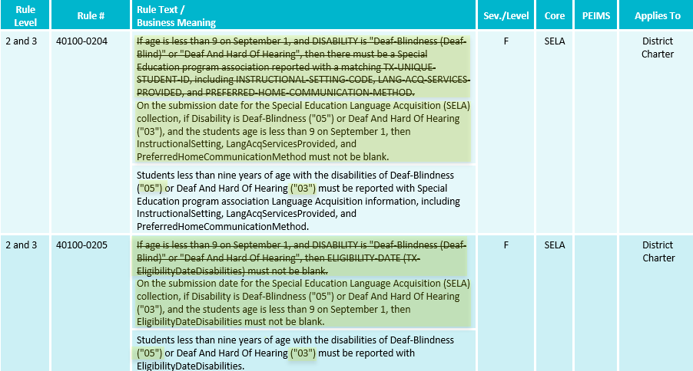
TSDS UPGRADE PROJECT UPDATES
Business Rule Changes:
Uses Disability ’05’ and ‘03’ descriptor values replacing ‘Deaf Blindness’ and ‘Deaf And Hard of Hearing’

Slide 61
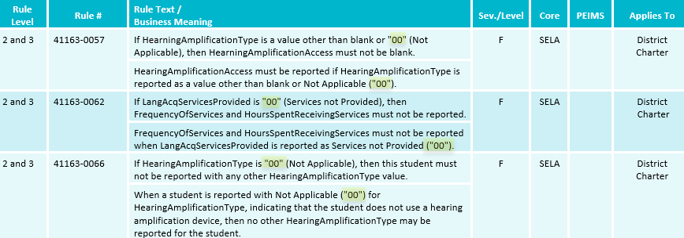
TSDS UPGRADE PROJECT UPDATES
Business Rule Changes:
Example of rules that use ‘00’descriptor values instead of code value description:

Slide 62
TSDS UPGRADE PROJECT UPDATES
Business Rule Changes:
The following business rules have been added:

Slide 63
TSDS UPGRADE PROJECT UPDATES
Business Rule Changes:
Deleted Data Validation Rule 30040-0029
Uses STAFF-IDENTIFICATION-SYSTEM-TYPE which is not used in TSDS Upgrade Project.

Slide 64
TSDS UPGRADE PROJECT UPDATES
NEW Entity/Common Type Change

Slide 65
FREQUENTLY ASKED QUESTIONS
When a student is being reported with two DISABILITY (E1220) codes (‘Deaf and Hard of Hearing’ and ‘Developmental Delay’), does the ELIGIBILITY-DATE (E1723) need to be reported for both disabilities? What about the EFFECTIVE-DATE (E1632)??
ELIGIBLILITY-DATE (E1723) shall only be reported with the ‘Deaf and Hard of Hearing’ disability code. It does not need to be reported with ‘Developmental Delay’. EFFECTIVE-DATE (E1632) will need to be reported for both disabilities. However, this date is not promoted to the SELA data mart for either. It is only required to load the data to the IODS.

Slide 66
TITLE SLIDE: ESC Vendor Training for One Component
Child Find (SPPI-11 and SPPI-12)

Slide 67
CHILD FIND (SPPI-11 & SPPI-12) TIMELINE

Slide 68
Data Entry Errors
Notes:
Some items triggering noncompliance are preventable with careful planning and data review.

Slide 69
Most Common Data Entry Errors
Attendance
Calendar issues
Human error
Transfer Students
Notes:
As our team works with LEAs in the clarification process, we routinely see one or more of these areas noted as the reason for noncompliance. The LEA is engaging in clarifications to provide the correct data, not corrected data, correct data-meaning they are able to demonstrate they were initially compliant but for some reason data uploaded and submitted in TSDS triggered noncompliance. With proper planning and the implementation of routine data reviews, LEAs can prevent the need for clarification and have higher SPPI compliance.

Slide 70
Attendance and Full Individual and Initial Evaluation (FIIE)
§89.1011. Full Individual and Initial Evaluation
If a parent submits a written request to a school district's director of special education services or to a district administrative employee for a full individual and initial evaluation of a student, the school district must…
§89.1011 (c) Except as otherwise provided in this section, a written report of a full individual and initial evaluation of a student must be completed as follows:
(1) not later than the 45th school day following the date on which the school district receives written consent for the evaluation from the student's parent, except that if a student has been absent from school during that period on three or more school days, that period must be extended by a number of school days equal to the number of school days during that period on which the student has been absent; …
Notes:
89.1011 defines the timeline full Individual and initial evaluations (FIIEs) must be completed within as well as allowable exceptions to the timeline. (Read slide an emphasize the bold font in 3rd bullet.

Slide 71
FIIE Absence Definition
§89.1011 (h) For purposes of subsections (c)(1) and (e) of this section, a student is considered absent for the school day if the student is not in attendance at the school's official attendance taking time or at the alternate attendance taking time set for that student. A student is considered in attendance if the student is off campus participating in an activity that is approved by the school board and is under the direction of a professional staff member of the school district, or an adjunct staff member who has a minimum of a bachelor's degree and is eligible for participation in the Teacher Retirement System of Texas…
Notes:
89.1011 (h) defines absence as it relates to the FIIE timeline compliance. Read slide emphasis on bold font

Slide 72
FIIE Absence Example
Consent signed 2/1/2024. Official attendance taking period is 2nd period. On 2/5 the student is not present and is marked absent. Student is still not present when the evaluator comes to pull the student for their evaluation. Evaluator marks the student as absent in the electronic IEP system/evaluation log. Student returns in 4th period with a doctor’s note. Absence in TSDS is changed to present. Student is absent again 2/20 and 3/8 which are captured by TSDS as absences. The evaluator shows 3 absences and extends the evaluation due date by the number of absences. The LEA submits their SPPI 11 data and is found to be noncompliant for this student. Why?
The evaluator and TSDS have competing data as the evaluator shows 3 absences for each time the student was not present at the official attendance taking period, but TSDS only shows 2 as the student returned to school in the first instance. Both are accurate however, not all systems capture the attendance taking absences when submitting the data for TSDS Child Find submissions.
Solution: LEAs should review TSDS data routinely to ensure absences as defined in §89.1011 (h) are accurately captured to avoid data entry errors and inaccurate noncompliance findings
Notes:
Let’s look at an example: Read slide

Slide 73
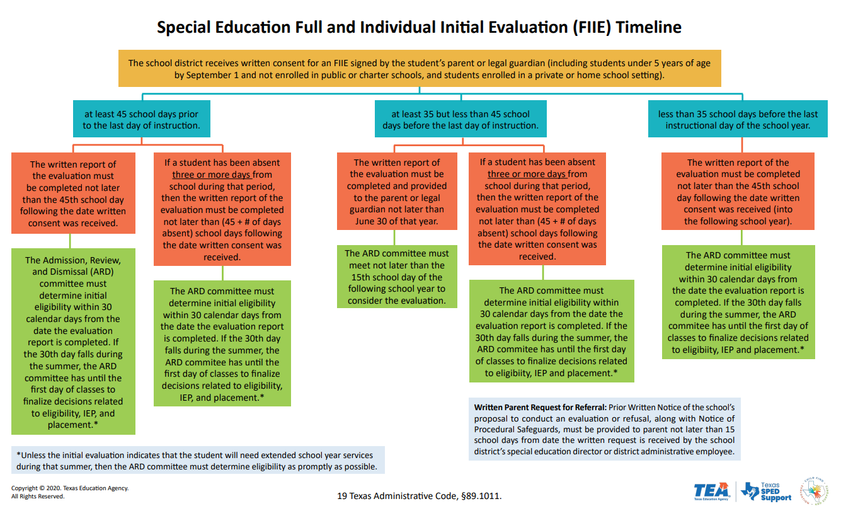
Calendar issues
FIIE compliance (11a) relies on the accurate calculation of school days.
School closures and changes to instructional days impact this calculation.
LEAs present updated calendars showing school closures and other calendar revisions during the clarification process.
Solution: Ensure the correct calendar is uploaded in the TSDS Child Find submission in July.
Notes:
Another area of preventable noncompliance stems from the version of the school calendar uploaded by the LEA during their TSDS submission. Read first two bullets and then expand on the 3rd by reading During the clarification process LEAs present updated calendars showing school closures and other calendar revisions. When SPPI 11a data is recalculated using the corrected calendar, the LEA is compliant with the FIIE timeline. Read solution bullet.

Slide 74
Human Errors
Since the TSDS Child Find collection pulls from 3rd party systems there is a possibility of data entry errors.
Most LEAs hand enter data into an electronic IEP data system that uploads into the LEA’s SIS and from there the upload to TSDS is generated.
Solution: LEAs should build a routine of checking their TSDS Child Find data reports to ensure all data is accurate and compliance checks are correct
Notes:
Read slide

Slide 75
Transfer Students §89.1011 (f)
§89.1011 (f) states:
If a student was in the process of being evaluated for special education eligibility by a school district and enrolls in another school district before the previous school district completed the full individual and initial evaluation, the new school district must coordinate with the previous school district as necessary and as expeditiously as possible to ensure a prompt completion of the evaluation in accordance with 34 CFR, §300.301(d)(2) and (e) and §300.304(c)(5). The timelines in subsections (c) and (e) of this section do not apply in such a situation if:
the new school district is making sufficient progress to ensure a prompt completion of the evaluation; and
the parent and the new school district agree to a specific time when the evaluation will be completed
LEAs provide the code 09 (other) to explain the delay for the student’s FIIE. During the clarification process, the LEA provides evidence that the student transferred during the evaluation process.
Solution: LEAs should use the delay reason codes 06 or 07 for transfer students when the elements of §89.1011 (f) are met by the LEA.
Notes:
The last common but preventable instance of noncompliance relates to students who transfer during the evaluation process. 89.1011 (f) states (read first bullet) Read solution and add-LEAs need to understand the purpose of each delay reason code as the accurate use of these codes could prevent the LEA from being determined noncompliant.

Slide 76
APPLICATION UPDATES
No application updates for the following:
Reports

Slide 77
ENTITY UPDATES

Slide 78
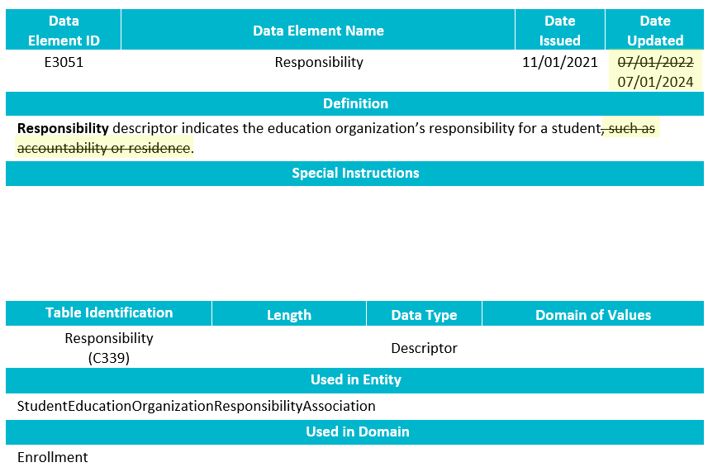
DATA ELEMENT UPDATES8
NEW Data Element Change:
E3051 Responsibility
Revised the definition.

Slide 79
TSDS UPGRADE PROJECT UPDATES
Data Element Name Changes:
Data Element ID | XML Data Element Name | Upgrade Data Element Name
E0975 | INSTRUCTIONAL-TRACK-INDICATOR-CODE | CalendarCode
E1168 | CALENDAR-DATE | Date
E1582 | SCHOOL-DAY-EVENT-CODE | CalendarEvent
E1600 | INSTRUCTIONAL-PROGRAM-TYPE | CalendarType
E3051 (was E1710) | CAMPUS-ID-OF-EVALUATION | Responsibility (where descriptor = ’03’ Evaluation)

Slide 80
TSDS UPGRADE PROJECT UPDATES
Data Element Name Changes:
Data Element ID | XML Data Element Name | Upgrade Data Element Name
E1711 | STUDENT-ABSENCES-WITHIN-TIMEFRAME | EvaluationDelayDays
E1712 | ECI-NOTIFICATION-DATE | TransitionNotificationDate
E1713 | ECI-TRANSITION-CONFERENCE-DATE | TransitionConferenceDate
E1715 | INITIAL-EVALUATION-DATE | EligibilityEvaluationDate
E1716 | SPED-ELIGIBILITY-DETERMINATION-DATE | EligibilityDeterminationDate
E1717 | SPED-ELIGIBILITY-DETERMINATION-CODE | IDEAIndicator

Slide 81
TSDS UPGRADE PROJECT UPDATES
Data Element Name Changes:
Data Element ID | XML Data Element Name | Upgrade Data Element Name
E3010 | N/A | BeginDate
E3020 | N/A | EndDate
E3016 | N/A | DisabilitySetBeginDate
E3017 | N/A | DisabilitySetEndDate
E3025 | N/A | InstructionalSettingBeginDate
E3026 | N/A | InstructionalSettingEndDate
E0266 | CAMPUS-ID | EducationOrganization (Reference)

Slide 82
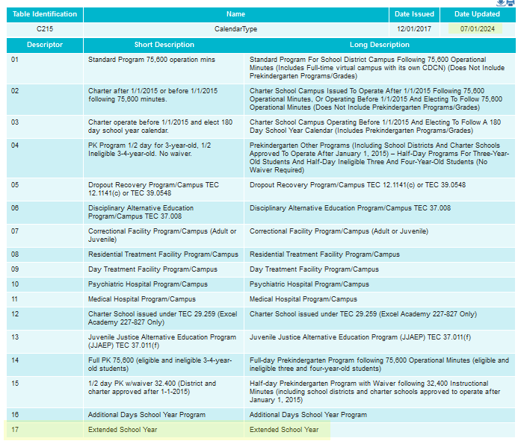
DESCRIPTOR TABLE UPDATES
NEW Descriptor Table Updates:

Slide 83
TSDS UPGRADE PROJECT UPDATES
Descriptor Table Name Changes:
Descriptor Table ID | XML Code Table Name | Upgrade Descriptor Table Name
C061 (was DC079) | EMERGENT-BILINGUAL-TYPE | EmergentBilingualIndicator
C318 (was DC160) | PERIOD-OF-TIME-ACCESS-CODE | HearingAmplificationAccess
C319 (was DC161) | AVERAGE-TIME-CODE | HearingAmplificationDailyUse
C303 (was DC096) | PROGRAM-TYPE | ProgramType
C053 (was DC142) | DISABILITY-TYPE | Disability
Notes:
DC096 PROGRAM-TYPE->C303 ProgramType:
C303 now only includes the following values:
04 Bilingual
05 Career and Technical Education
12 English as a Second Language (ESL)
33 Special Education
38 Title I Part A
DC142 DISABILITY TYPE->C053 Disability
C053 descriptor value updates (description reassigned to new code values)
01-Orthopedic Impairment
02-Other Health Impairment
03-Deaf And Hard Of Hearing
04-Deaf And Hard Of Hearing
05-Deaf-Blindness
06-Intellectual Disability
07-Emotional Disturbance
08-Specific Learning Disability
09-Speech or Language Impairment
10-Autism
12-Developmental Delay
13-Traumatic Brain Injury
14-Noncategorical Early Childhood

Slide 84
TSDS UPGRADE PROJECT UPDATES
Descriptor Table Name Changes:
Descriptor Table ID | XML Code Table Name | Upgrade Descriptor Table Name
C208 | SCHOOL-DAY-EVENT-CODE | CalendarEvent
C215 | INSTRUCTIONAL-PROGRAM-TYPE | CalendarType
C339 | N/A | Responsibility
C347 (was DC164) | DELAY-REASON-CODE | EligibilityDelayReason
C348 (was DC164) | DELAY-REASON-CODE | EvaluationDelayReason

Slide 85
BUSINESS RULE UPDATES
NEW Business Rule Changes:
The following business rules have been added:

Slide 86
BUSINESS RULE UPDATES
Business Rule Changes:
The following business rule has been added to ensure all students reported for Child Find are also reported with an evaluation campus.
The evaluation campus is the EducationOrganization (reference) reported in the StudentEducationOrganizationResponsibilityAssociation where Responsibility (E3051) = ‘03’ (Evaluation).

Slide 87
BUSINESS RULE UPDATES
Business Rule Changes:
The following rule has been updated to reflect the terminology changes made to the collection of evaluation campus information.
41163-0078 states that the SchoolId reported with a Responsibility = ‘03’ (Evaluation) must match an entry registered with TEA.
In the XML submission, this rule stated that the CAMPUS-ID-OF-EVALUATION must be a valid campus.

Slide 88
BUSINESS RULE UPDATES
Business Rule Changes:
Uses Disability ’05’ and ‘03’ descriptor values replacing ‘Deaf Blindness’ and ‘Deaf And Hard of Hearing’

Slide 89
BUSINESS RULE UPDATES
Business Rule Changes:
Example of rules that use ‘00’descriptor values instead of code value description:

Slide 90
BUSINESS RULE UPDATES
Business Rule Changes:
The following business rules have been added:

Slide 91
BUSINESS RULE UPDATES
Business Rule Changes:
Deleted Data Validation Rule 30040-0029
Uses STAFF-IDENTIFICATION-SYSTEM-TYPE which is not used in TSDS Upgrade Project.

Slide 92
QUESTIONS
QUESTIONS?

